Slide 1
C2P India
QA Track – Day 1

Slide 2
Introduction and Agenda
Opportunity To Learn OPF
Opportunity To Learn xCT
Learn QA Processes and Guidelines
Tools Used For Testing
Functional Hands On Exercise

Slide 3
OPF Academy – QA Training Scope
OPF training program provides training on QA Processes, Tools and OPF/ XCT exercises
Introduction To Wiki/Confluence
OPF Payment Testing Solution
SVN structure walkthrough
QA Involvement in SDLC

Slide 4
OPF Academy – QA Training Scope
Reading & Understanding Requirements
QA Tools Introduction
VSDK
JIRA
SPIRA
OPF xCT Functional Exercises
QA Checklists
Daily Training
Daily Assignments

Slide 5
Scope
Introduction To Wiki/Confluence
OPF Payment Testing Solution
SVN structure walkthrough
QA Involvement in SDLC

Slide 6
Introduction To Wiki/ Confluence
Wiki is a global space where you will be able to find information on the Products & Solutions Portfolio, Roadmaps, Teams, Competence Centers etc.
https://wiki.clear2pay.com/display/OPFOPS/Quality+Assurance+Competence+Center
https://wiki.clear2pay.com/display/OKB/Quality+Assurance+KB
https://wiki.clear2pay.com/pages/viewblogposts.action?period=2&postingDate=2014%2F11%2F1&key=OTS
Login with your domain credentials.

Slide 7
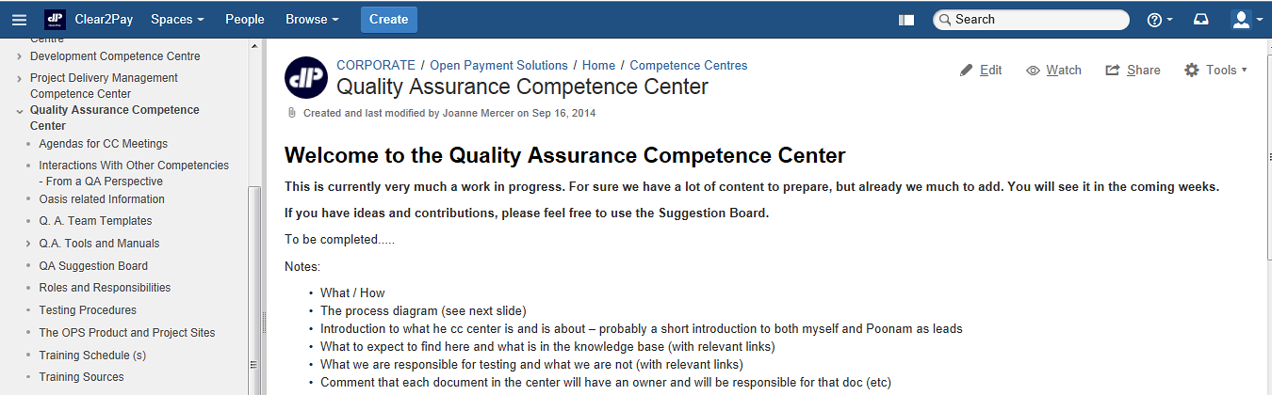
Wiki - QA Competence Center
https://wiki.clear2pay.com/display/OPFOPS/Quality+Assurance+Competence+Center

Slide 8
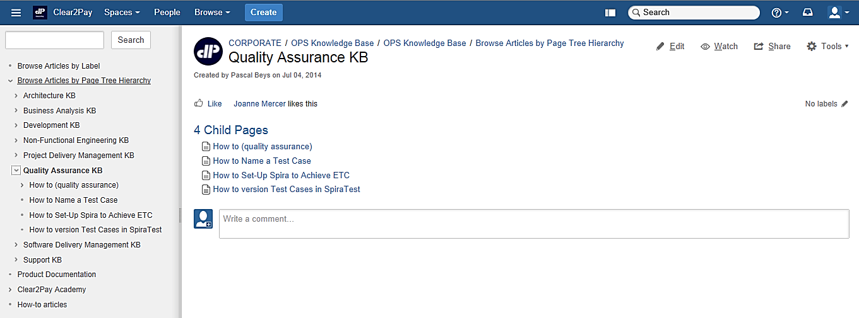
Wiki - QA Knowledge Base
https://wiki.clear2pay.com/display/OKB/Quality+Assurance+KB

Slide 9
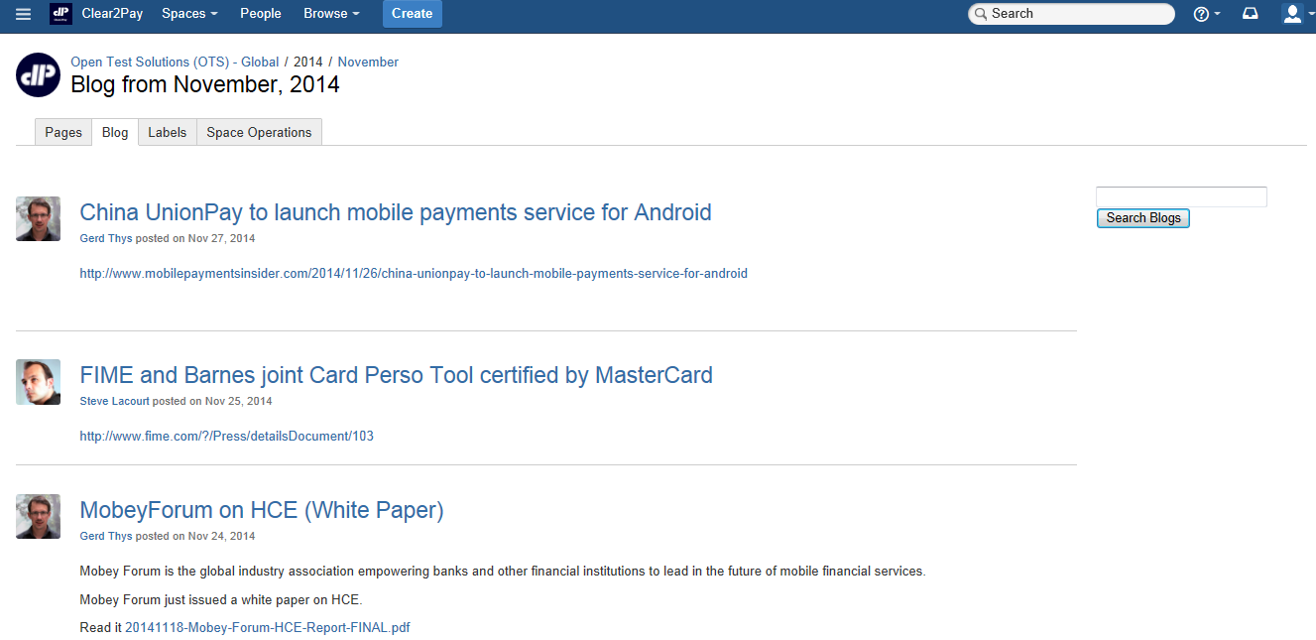
Wiki - Blog Sharing
https://wiki.clear2pay.com/pages/viewblogposts.action?period=2&postingDate=2014%2F11%2F1&key=OTS

Slide 10
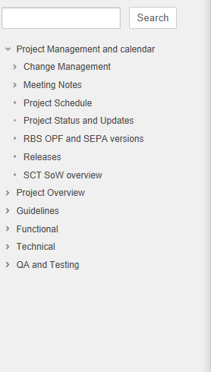
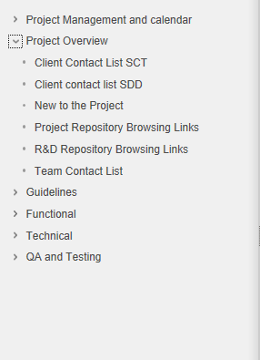
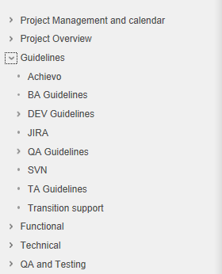
Wiki - Project Specific Info

Slide 11
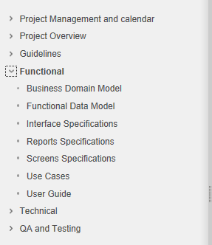
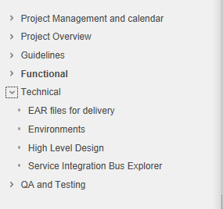
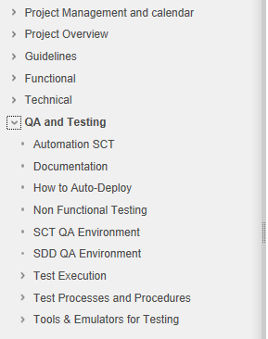
Wiki - Project Specific Info

Slide 12
Scope
Introduction To Wiki/Confluence
OPF Payment Testing Solution
SVN structure walkthrough
QA Involvement in SDLC

Slide 13
OPF Payment Testing Solution
Managed Service for Testing All Aspects of a Payment Environment
Payment testing Lifecycle
Accelerators
Initiation
Team Identification
Kick Off Meeting
Planning
Scheduling
Test Strategy / Test Planning
Test Design
Test Scenario / Cases / Data
Execution & Reporting
Project On-boarding
Tool Set-up
Traceability Matrix
Test Case Review and Sign-Off
Manual and Automation
Defect Management
Status Reporting / Sign-Off
Test
Repository
Domain
Experience
Test
Automation
ISO 20022, SEPA, US/UK/SG Payments
OASIS – E2E Test Automation
Full Testing Coverage
Functional
Interface
Regression
New Systems, Business Enhancements, Regulatory Compliance
Key Benefits
Experienced
Good Quality
Proven

Slide 14
OPF QA Delivery Model
OPF Engagement 1
OPF Engagement 2
OPF Engagement 3
Optimal resource utilization
Payment SME facilitate smooth knowledge acquisition
Automation experts define automation strategy and framework
Experienced OPF QA specialist help in test preparation & execution
Supported and managed by well qualified, experienced management team
OPF QA Specialist
(dedicated team)
OPF QA Specialist
(dedicated team)
OPF QA Specialist
(dedicated team)
Payments Subject Matter Experts
Delivery/Test Management and Project Monitoring
Shared Automation Framework Resource Pool
OPF QA CC: Process Implementation & Monitoring
Resource Management & Training Fulfillment

Slide 15
Scope
Introduction To Wiki/Confluence
OPF Payment Testing Solution
SVN structure walkthrough
QA Involvement in SDLC

Slide 16
QA Involvement in SDLC
Functional Test Team
Business (BA Group)
Delivery Management
Development / Technical Architecture
Software Configuration Management
Elaboration Phase
Project Kick Off meetings.
Construction Phase
Functional Testing and KT from BA.
Technical support from Dev/TA.
Transition Phase
Functional Testing and KT from BA.
Technical support from Dev/TA.
Knowledge transfers from BA to facilitate test planning and scheduling.

Slide 17
Scope
Introduction To Wiki/Confluence
OPF Payment Testing Solution
SVN structure walkthrough
QA Involvement in SDLC

Slide 18
SVN
About SVN
Apache Subversion (often abbreviated SVN, after the command name svn) is a Software Versioning and a Revision Control system.
It is where we store all our documentation.
OPF
https://svn-mec.clear2pay.com/svn/repos/rd/core/OPF/trunk/doc
XCT
https://svn-mec.clear2pay.com/svn/repos/rd/core/XCT/trunk/doc
It is suggested that the tester should take the checkout on its local working directory.

Slide 19
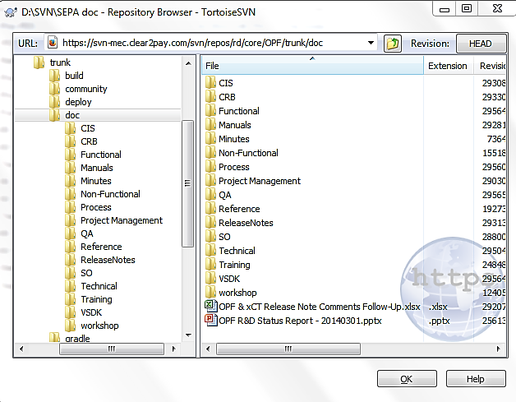
SVN Structure
Documents
All the documents are stored in their respective SVN location (i.e. under .../trunk/doc/...) as can be seen below.

Slide 20
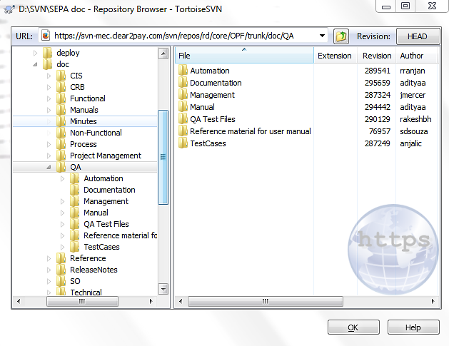
SVN Structure - QA
QA documents
All the QA docs are stored in their respective SVN location (i.e. under .../trunk/doc/...) as can be seen below. This includes all test data used.

Slide 21
SVN Structure – Requirements (1)
Specifications
All the functional specifications like Use Cases and Functional Flow are held here:
Product | Specifications and reference documentation
OPF | https://svn-mec.clear2pay.com/svn/repos/rd/core/OPF/trunk/doc/Functional
XCT | https://svn-mec.clear2pay.com/svn/repos/rd/core/XCT/trunk/doc/Functional

Slide 22
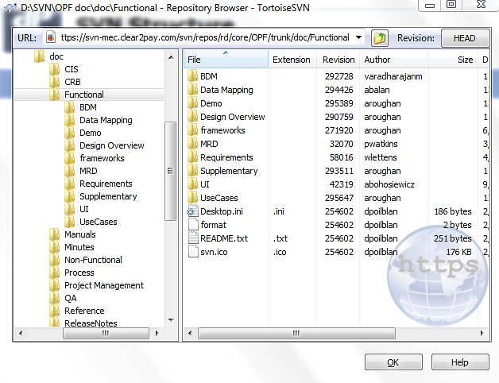
SVN Structure – Requirements (2)
Specifications

Slide 23
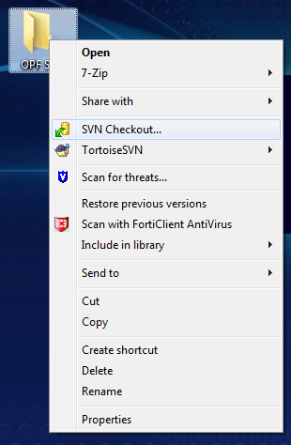
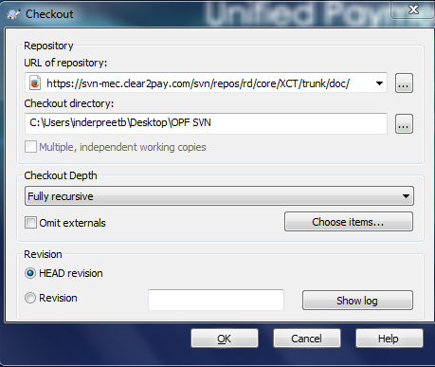
SVN Checkout

Slide 24
C2P India
QA Track – Day 2
QA Process Checklist

Slide 25
Introduction and Agenda
QA Process Checklist
Reading and understanding Requirements
MCQ

Slide 26
TC Drafting Checklist
A Standard set of Test Case Drafting Checklist has been framed to be followed across Projects/Products in C2P
The snapshots below are from standard checklist that should be used for Project/Product.
The Checklist will help in maintaining the synchronization between different Projects/Products
The Checklist will also help in Resource grabbing the basic things faster in case of Project switch.

Slide 27
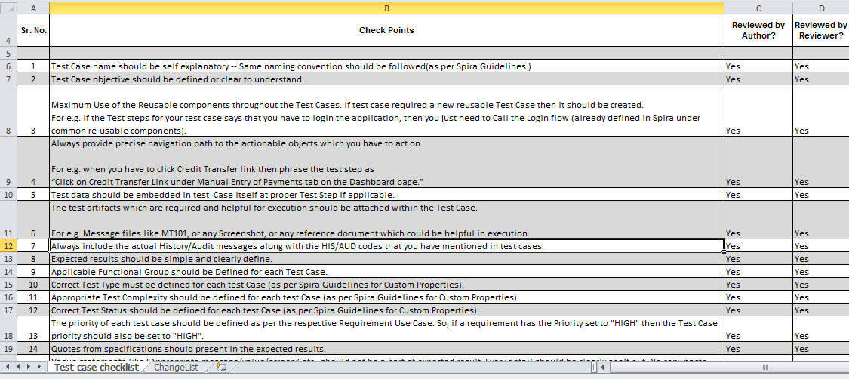
TC Drafting Checklist
A Standard set of Test Case Drafting Checklist has been framed to be followed across Projects/Products in C2P

Slide 28
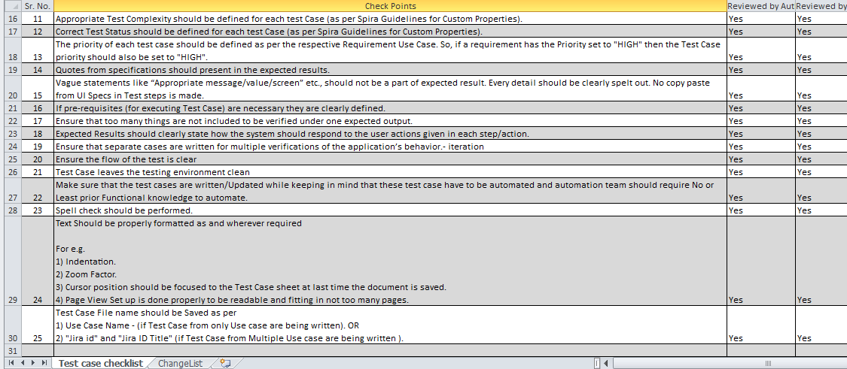
TC Drafting Checklist
A Standard set of Test Case Drafting Checklist has been framed to be followed across Projects/Products in C2P

Slide 29
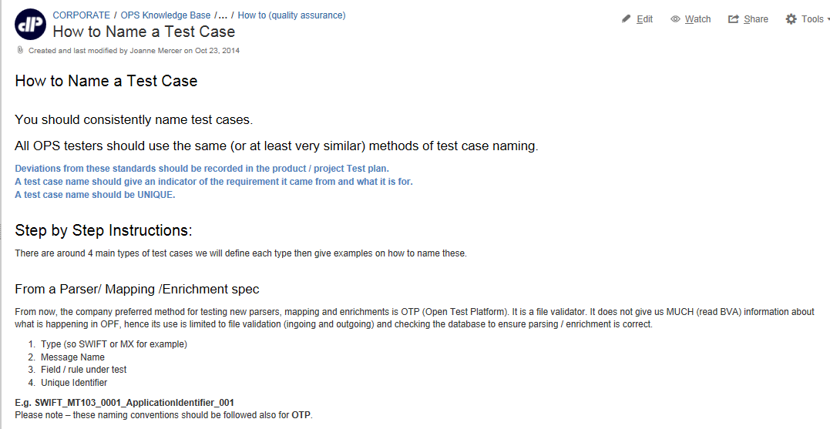
How to Name a TC
Following snapshot gives reference on How to Name a TC

Slide 30
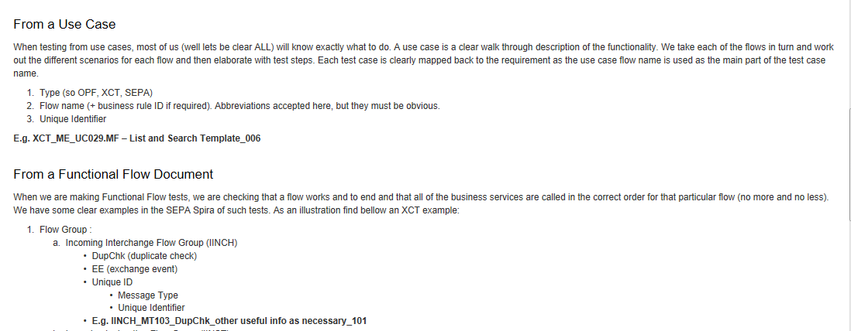
How to Name a TC
Following snapshot gives reference to How to Name a TC

Slide 31
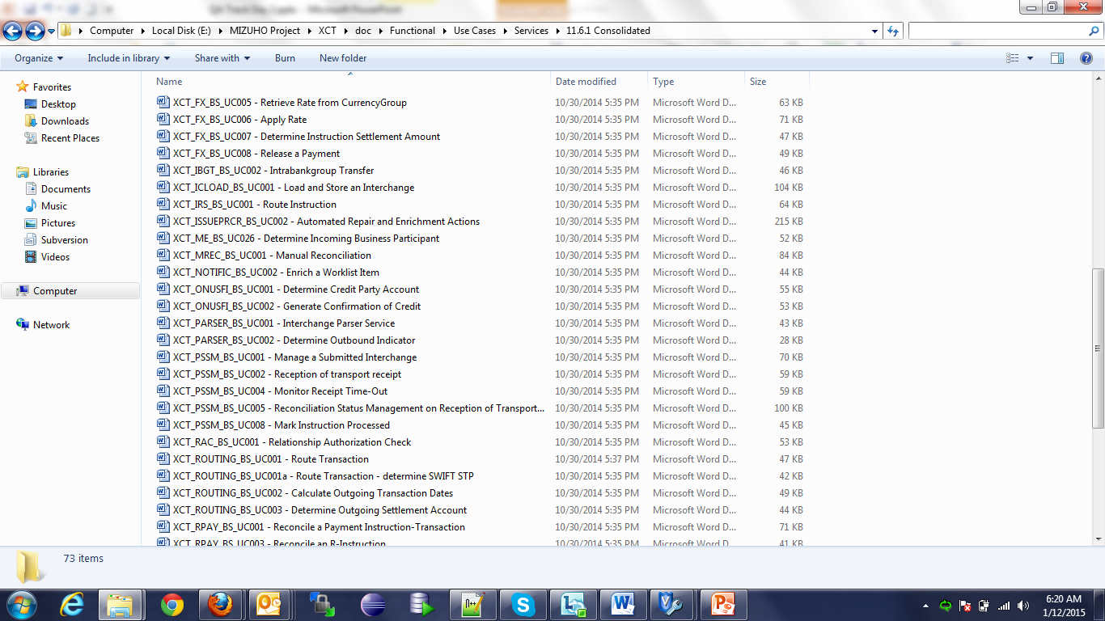
Reading and understanding Requirements
This section covers on how to understand the XCT Use Case which has reference to OPF/SEPA Use Case and any other Requirement documents
Open the Use Case from the following XCT SVN Location: https://svn-mec.clear2pay.com/svn/repos/rd/core/XCT/trunk/doc/Functional/Use Cases/Services/11.6.1 Consolidated/XCT_PARSER_BS_UC001 - Interchange Parser Service

Slide 32
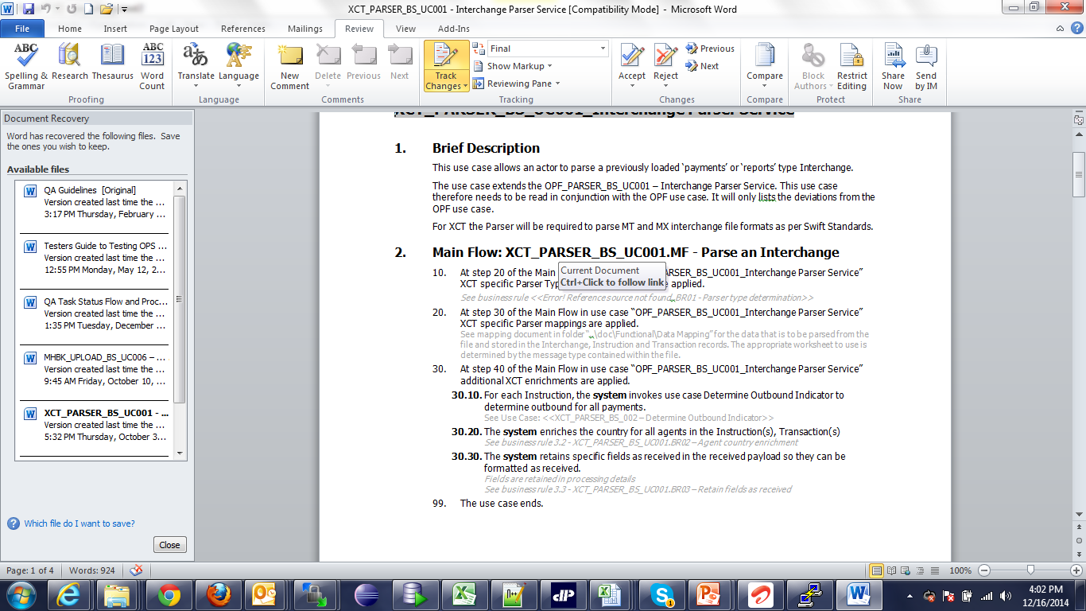
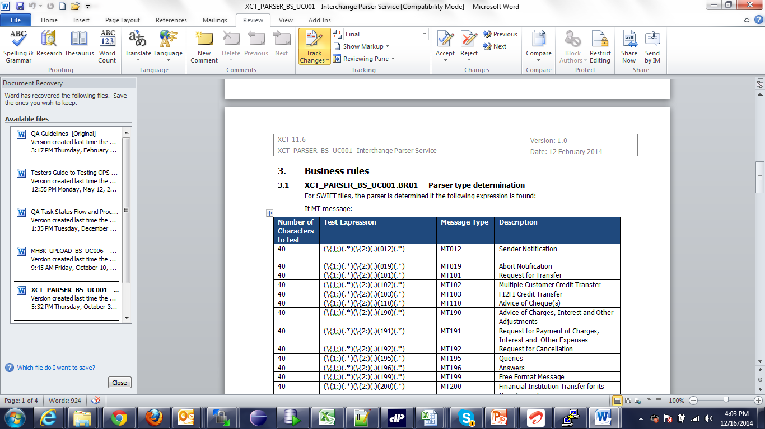
Reading and understanding Requirements
Use Case will have Brief Description, Main Flow, Alternate Flows, Exception flows, Extension Points, Business Rules, Revision History etc. This particular Use Case however has few sections only.

Slide 33
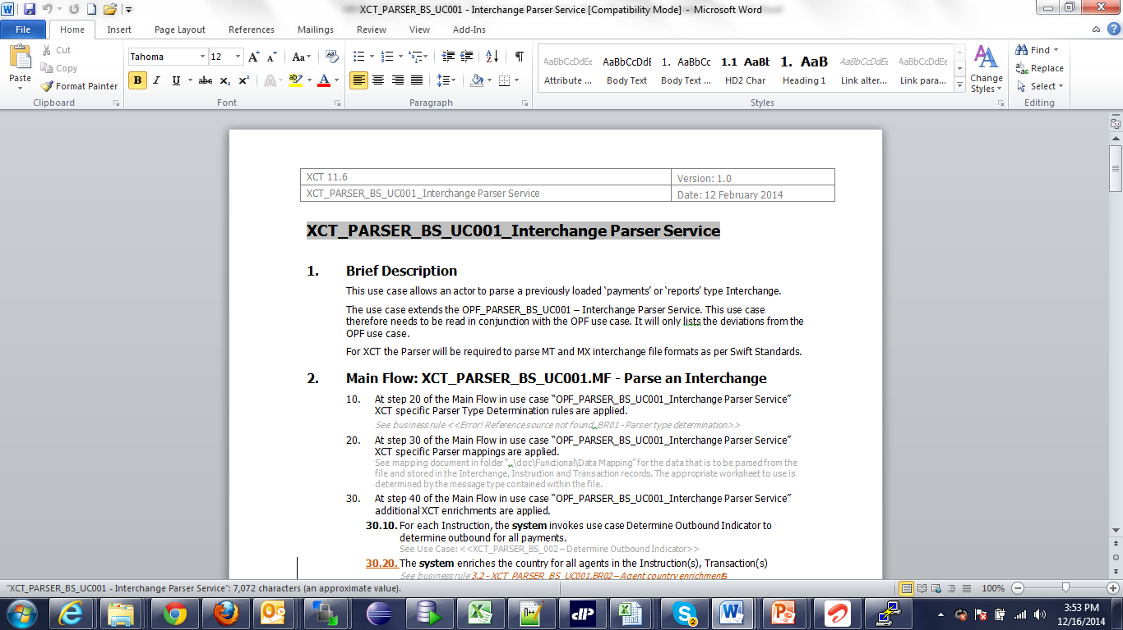
Reading and understanding Requirements
The Use Cases are designed in such a way that they are re-usable and refer to only customization on top of OPF/SEPA Layer.
In many Use case, one can find that Brief Description may often refer to OPF/SEPA Use Case. Lets go through this Use Case.
In the brief Description, Use refers to “OPF_PARSER_BS_UC001 – Interchange Parser Service”

Slide 34
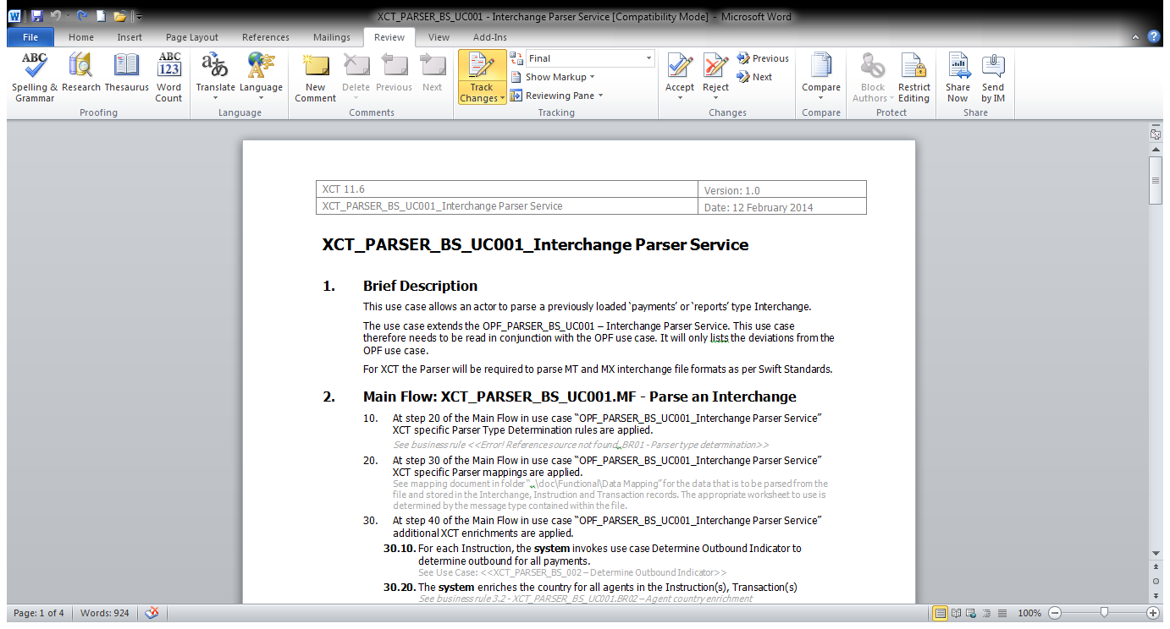
Reading and understanding Requirements
In the Main flow, we can notice that it refers to Mapping document and mapping document needs to be opened and covered as part of testing:
Mapping documents needs to be referred according to file type to be used.

Slide 35
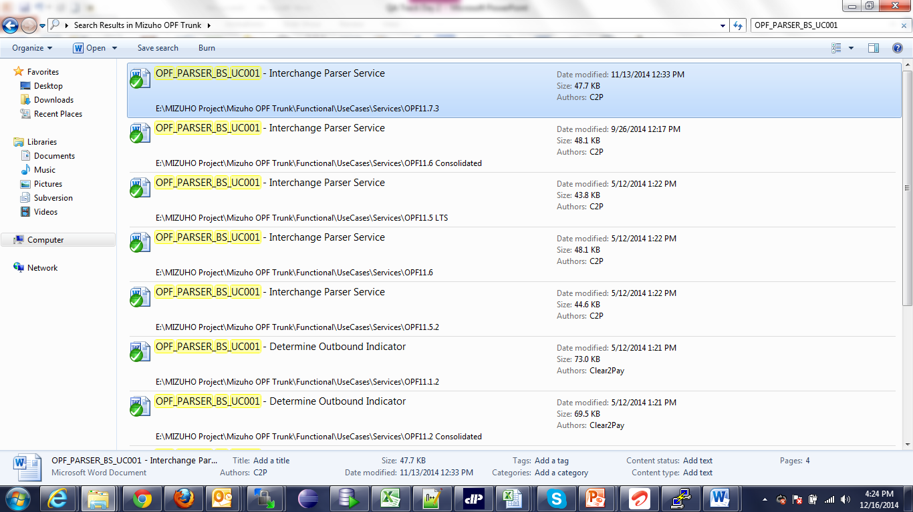
Reading and understanding Requirements
In order to understand this Use case, we need to go through the OPF Use Case. Navigate to following path:
https://svn-mec.clear2pay.com/svn/repos/rd/core/OPF/trunk
and search for OPF_PARSER_BS_UC001 – Interchange Parser Service

Slide 36
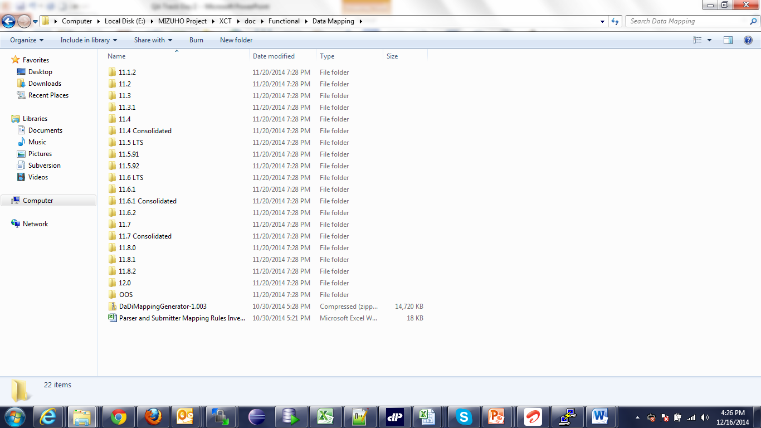
Reading and understanding Requirements
According to the OPF Version installation in Project, open the relevant Use Case and go through the whole Use Case.
Any other reference of Use Case, if given in the OPF Use Case has to be searched though the same mechanism.
For Data Mapping of file formats, navigate to the following path and open the relevant sheet:
https://svn-mec.clear2pay.com/svn/repos/rd/core/OPF/trunk/doc/Functional/Data Mapping/11.7 Consolidated

Slide 37
Reading and understanding Requirements
10. Test Scenario need to be designed based on Main flow, Alternate flow etc. and covering all the aspects of the Use Case. One may also need to cover the functionality from OPF Use case.
11. After analysis of the requirements, in case of any queries, QA can write down the queries in Query log /JIRA and BA can respond to those queries accordingly.

Slide 38
C2P India
QA Track – Day 3
QA Tools

Slide 39

TABLE OF CONTENTS
1
Overview
2
NotePad++
3
SQL Developer
4
Winscp
5
Putty

Slide 40
Overview
This section gives an overview of various small software’s which tester is expected to have on his machine
Software | Usage
Notepad ++ (with XML tools plug-in if possible) | Manipulating and editing test files
SQL Developer | Database queries
Win SCP | For accessing servers (copying log files ,etc)
PuTTY | For viewing system logs (especially in tail mode)

Slide 41
Notepad++
Notepad+ + is a text editor and source code editor for Windows. Its advantage it allows is tabbed editing, to easily work with multiple open files. Distributed as free software and is excellent for manipulating XML files.
Features:
Displays XML files in a nice readable manner.
Tabbed document interface
Drag-and-drop
Multiple Clipboard (plugin required)
Split screen editing and synchronized scrolling
Spell checker
Supports text encoding formats such as Unicode, for international writing systems
Find and replace over multiple documents
File comparison
Zooming

Slide 42
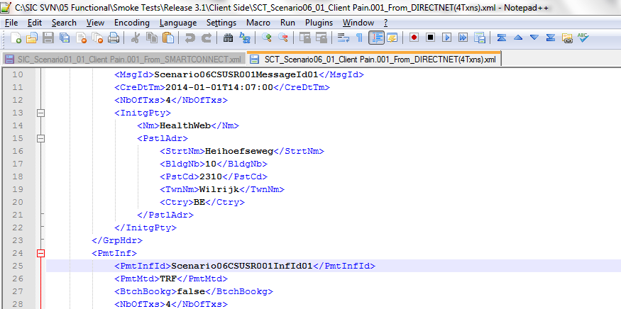
Notepad++ Snapshot

Slide 43
SQL Developer
Oracle SQL Developer is an IDE for working with SQL in Oracle databases. Oracle Corporation provides this product free; it uses the Java Development Kit. We use it to extract information from the database.
How to use SQL Developer:
Connect to the correct database:
Each time you connect to a NEW database, the following information is required to make the connection:
Connection Name – enter a name here for which you will ready recognise the connection the next time you want to use it.
Username – for all internal test servers = bphadmin.
Password = password.
Hostname = IP address of server (or alias / domain name)
Port = 1521
SID = bph

Slide 44
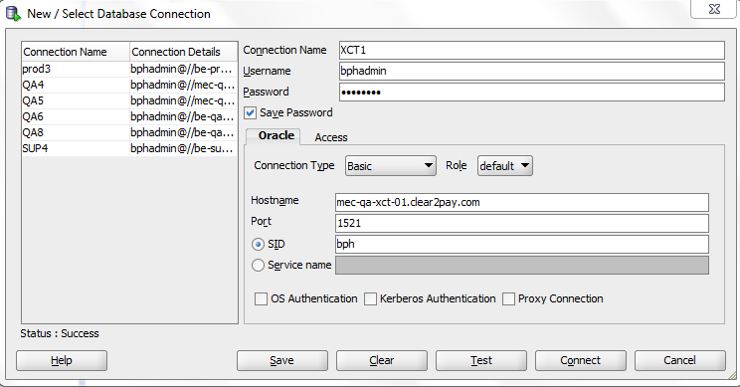
SQL Developer - Connecting to DB

Slide 45
WinSCP
WinSCP (Windows Secure CoPy) is a free and open source SFTP and FTP client for Microsoft Windows. Its main function is secure file transfer between a local and a remote computer. Beyond this, WinSCP offers basic file manager and file synchronisation functionality.
Features:
User is allowed to copy data from local machine to server via just drag and drop
Also the data from server to local machine cab be copied directly.
View the data in Winscp directly.
Open the data in local editor. When the doc is saved remote version is updated automatically.
Connecting to Server:
Each time you connect to a NEW server, the following information is required to make the connection:
Host Name = IP address of server (or alias / domain name)
Port # = 22
Username (for all internal test servers) = wasadmin
Password = password

Slide 46
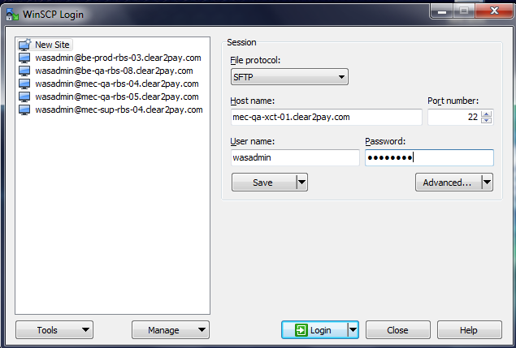
WinSCP - Connecting to server

Slide 47
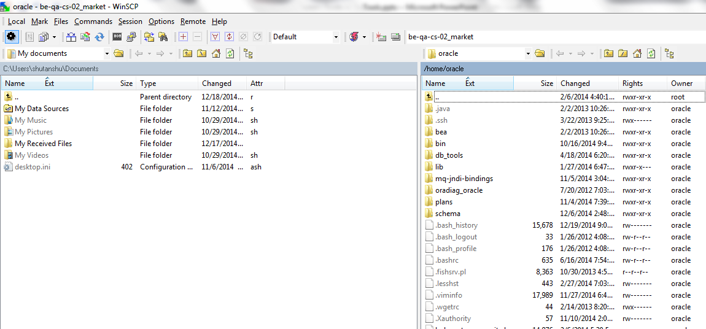
WinSCP - Snapshot

Slide 48
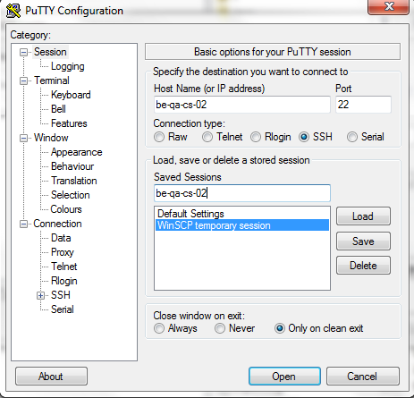
PuTTY
Putty is a tool used for Viewing/searching and scrolling though logs during QA execution.
Viewing Logs Using Putty
1.Connect to the server as wasadmin (see above)
a.In some server you have the possibility to enter the comment ./viewlog which is a shortcut to the log and will automatically open it in tail mode)
2.Go to the location of logs by typing ‘cdlogs’ and press <enter>
3.The command ‘ls’ (or ‘dir’) will give you a directory list - there should be SystemOut.log.
4.Type <less log file name> and press enter. So type <less SystemOut.log>
5.The following commands will help viewing the logs:-
a.<shift f> = tail mode
b.<ctrl C> = quit tail mode
c.shift g = takes you to the end of the log file
d.<line number + shift g> directs you to line number specified (e.g. 1 shift g = start)
e.you can scroll the logs using the arrows, and page up and down.
f.‘q’ to quit
g./ word enables a search of the log (‘n’ for next ; ‘b’ for back)
6.You can also use the command <tail –f log file name>; this puts you directly into ‘tail’ mode. So this would be tail -f SystemOut.log <enter>
7.Clicking on the top left ‘computer icon’ displays the options menu – for copying, opening other sessions etc.
8.As an additional help, once you have executed step (g), from the $ prompt, type ./viewlogs - this command will put you directly into tail mode.

Slide 49
C2P India
QA Track – Day 4
OPF Visual Software Development

Slide 50
Training Agenda
Installation and setup of VSDK
VSDK View and Editor

Slide 51
What is OPF VSDK?
VSDK is a graphical tool to simplify the configuration of an OPF based implementation
The main objective of the OPF VSDK is to simplify and standardize the configuration of a custom OPF implementation so that the overall implementation energy can be significantly reduced and the amount of errors can be minimized.
Regional and project specific settings for the data dictionary, parser formats, validation rules, submission formats, etc. can be visually configured utilizing a number of proven configuration patterns.

Slide 52
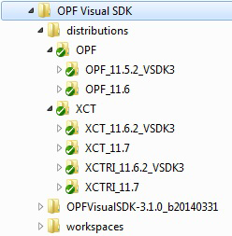
Setup of VSDK Directories
Create a local directory (aka OPF Visual SDK “home directory”) to hold your OPF Visual SDK artefacts (e.g. c:\OPF Visual SDK)
Create a subfolder “\distributions” that will store local copies of the SVN repository. This is the directory in which you will checkout files from SVN.
Create a subfolder “\workspaces” that will hold the different workspaces that you are working on
Install the software (from the software repository or media) into the OPF Visual SDK home directory

Slide 53
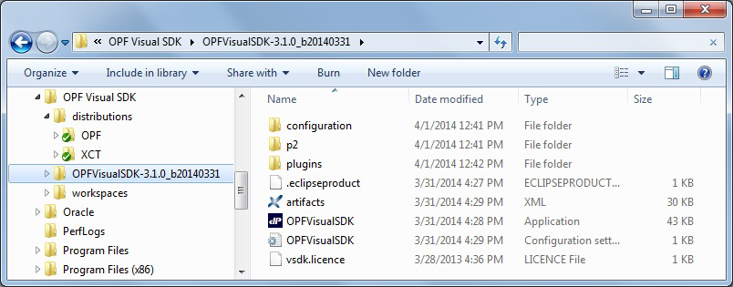
Download VSDK
Download the latest version from https://libra.clear2pay.com/vsdk/
Credential to access the link is same as SVN
Copy the “OPFVisualSDK-3.x-….zip” file (the one appropriate for your hardware) to a local drive and unzip in your OPF Visual SDK “home directory”. This will create a software subdirectory “\OPFVisualSDK-3.x…” that contains the OPFVisualSDK.exe file.
Copy the vsdk.license file into the software directory.

Slide 54
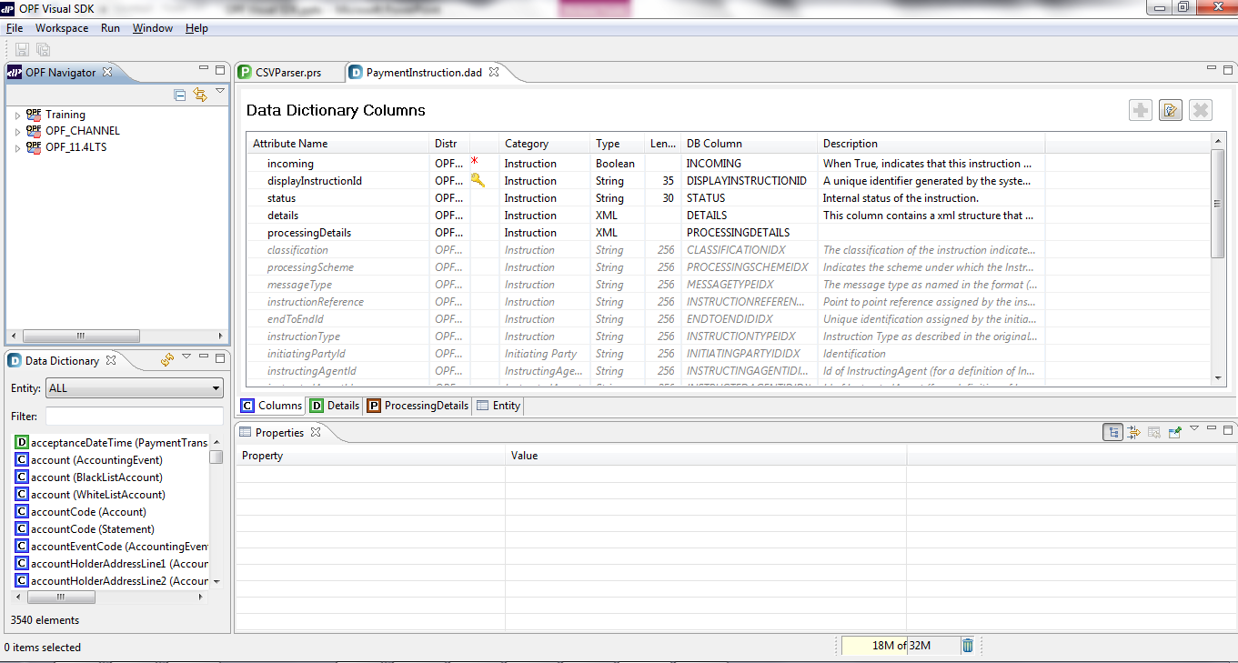
VSDK – Views and Editor
VIEW
EDITOR
VIEW

Slide 55
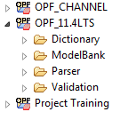
VSDK – Distributions
A “Distribution” is a self-contained set of files, grouped into a well-defined directory structure that will hold the functionality of a given OPF layer.
The OPF Distribution will contain the OPF data dictionary, a set of default validation rules that can be included in other distributions, etc.
The regional development teams (e.g. SEPA, FedWire) will build their Distribution on top of OPF and include regional-specific functionality.
A project team will take the OPF and optionally the regional Distribution (depending on the kind of solution they are customizing) and add their project-specific requirements on top of this

Slide 56
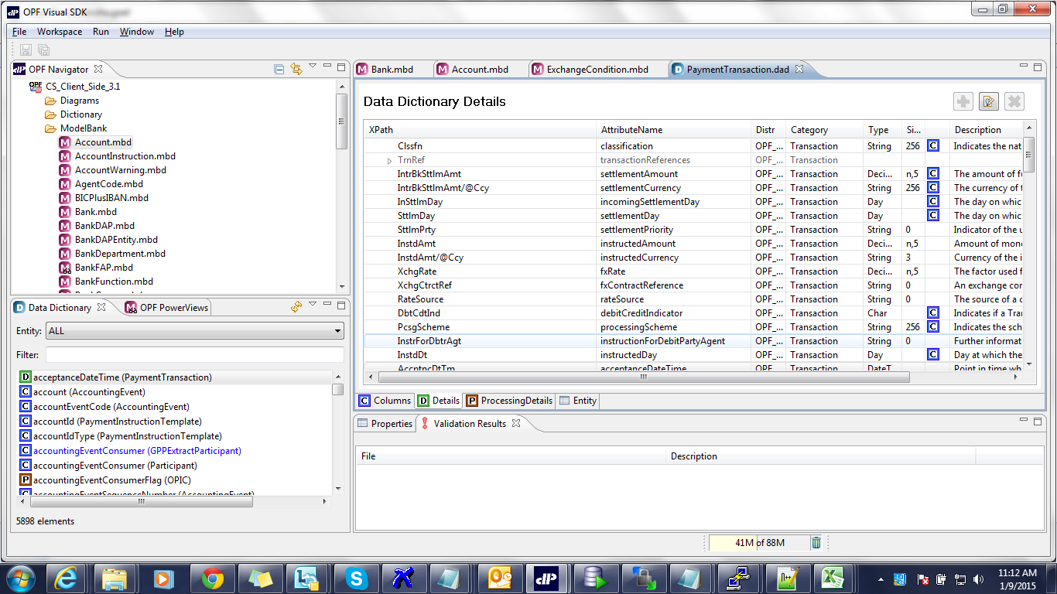
Model Bank view in VSDK

Slide 57
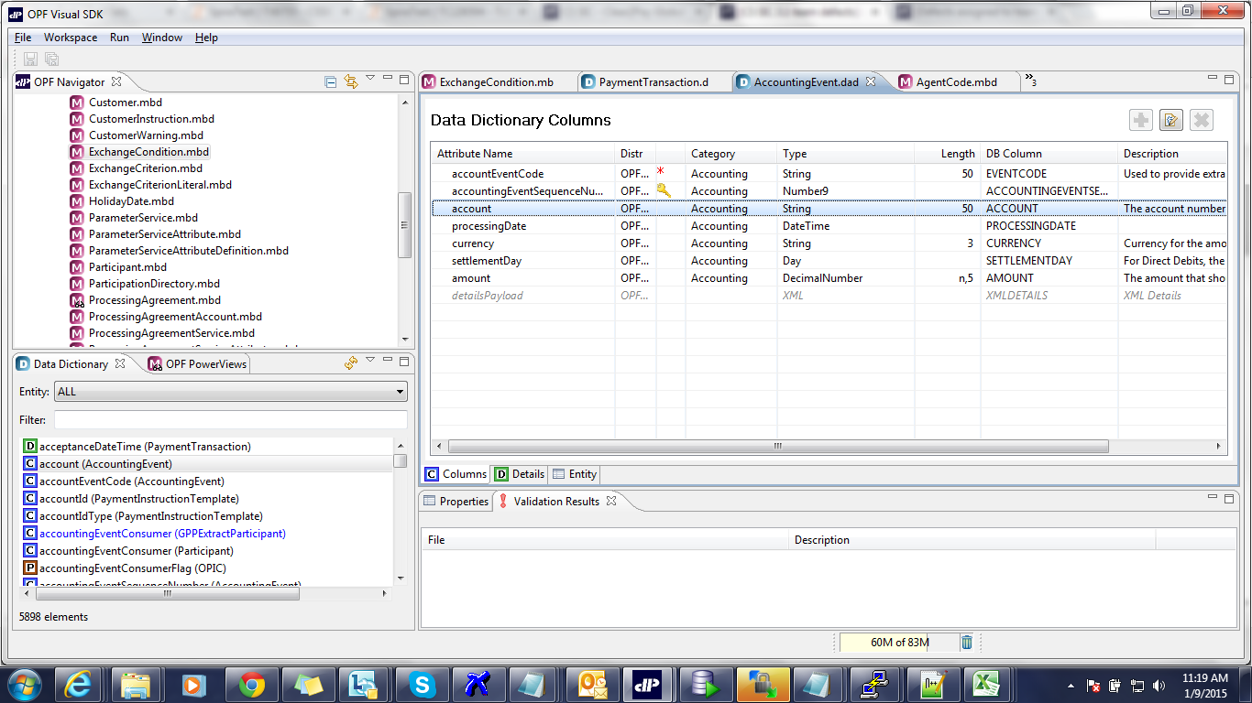
Attributes look up using VSDK

Slide 58
C2P India
QA Track- Day 5
JIRA

Slide 59
Introduction and Agenda
Using JIRA
Bug Life Cycle
Bug Logging guidelines

Slide 60
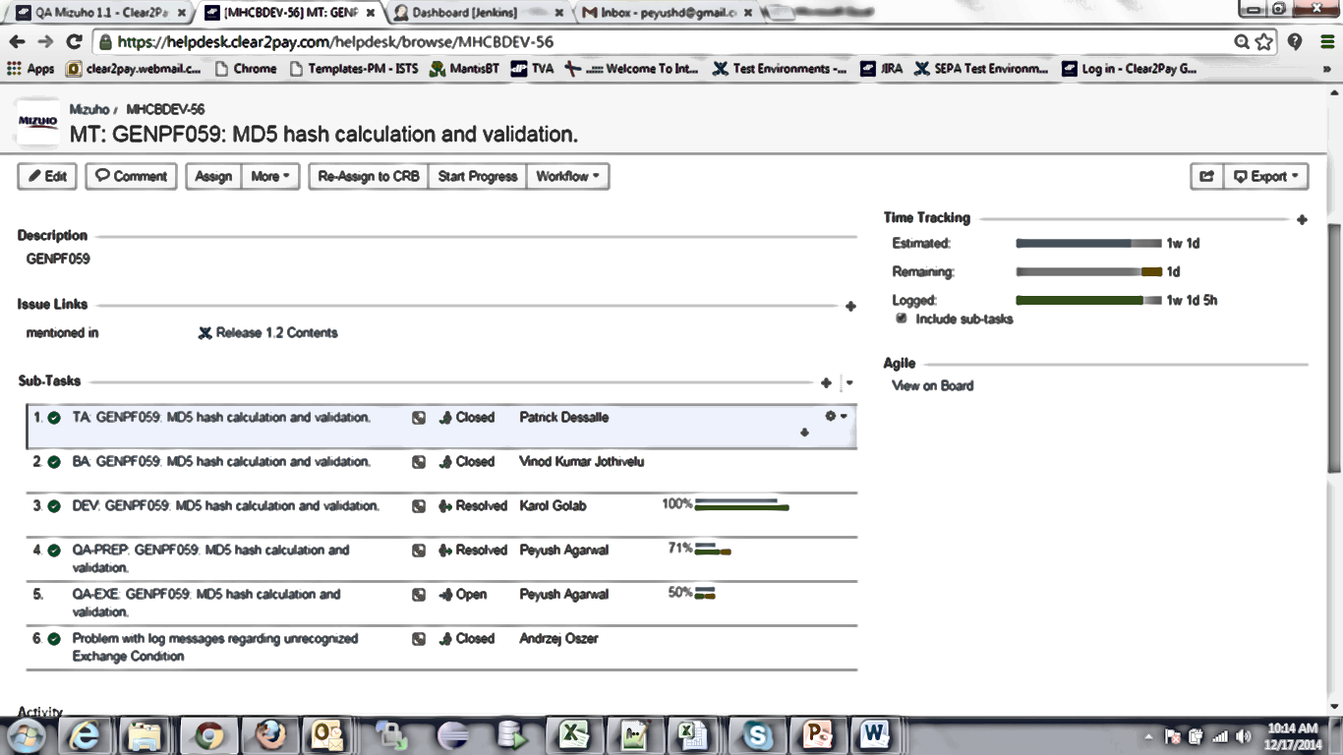
JIRA and different QA Task States
JIRA is being used across all Projects/Products in C2P by QA,Dev, TA & BA for Task related to Project features
Login to following link with your System credentials:
https://helpdesk.clear2pay.com/helpdesk/
For any features, a Main Task is created and then BA, TA and Dev will create their respective sub-task within that Main Task. QA creates 2 types of Sub-Task : QA-Prep and QA-Exe

Slide 61
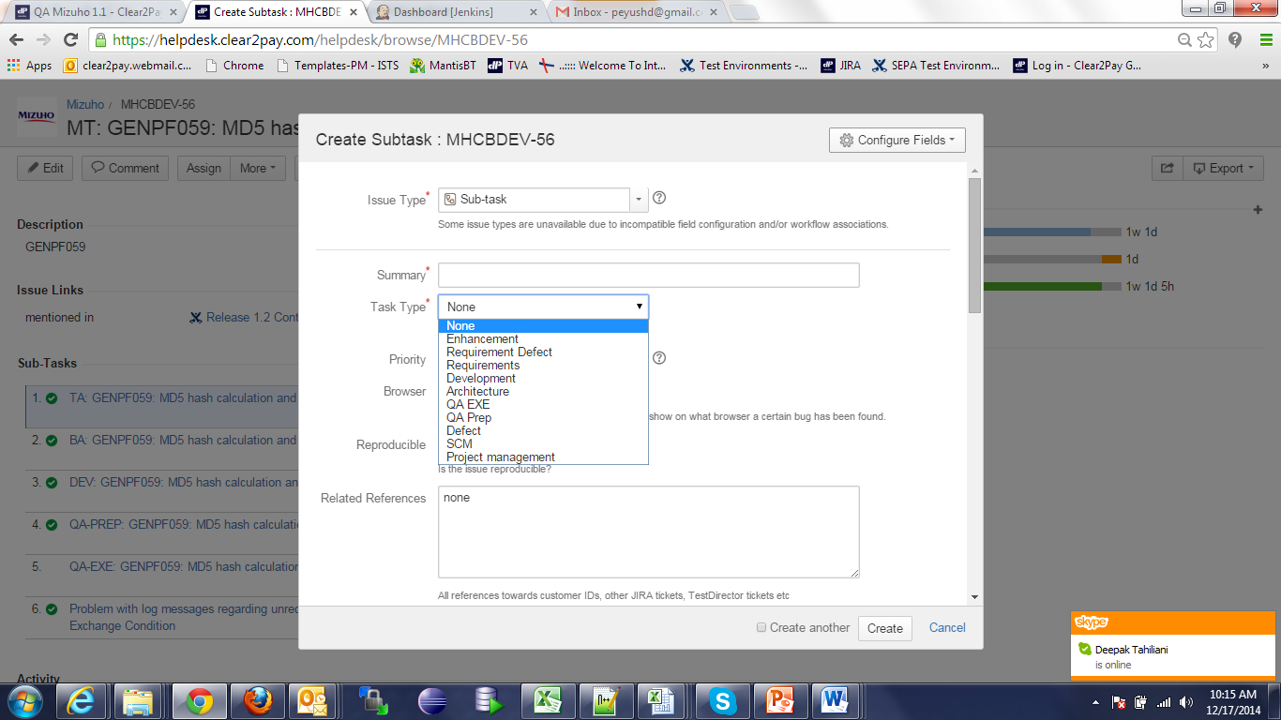
QA-Prep JIRA
The above task are created by respective Leads in all the projects. In order to create a sub-task, open the Main task in JIRA, Click on more – Create Sub-task and following screen will come up. For QA Prep task, we have to select Task Type as QA Prep

Slide 62
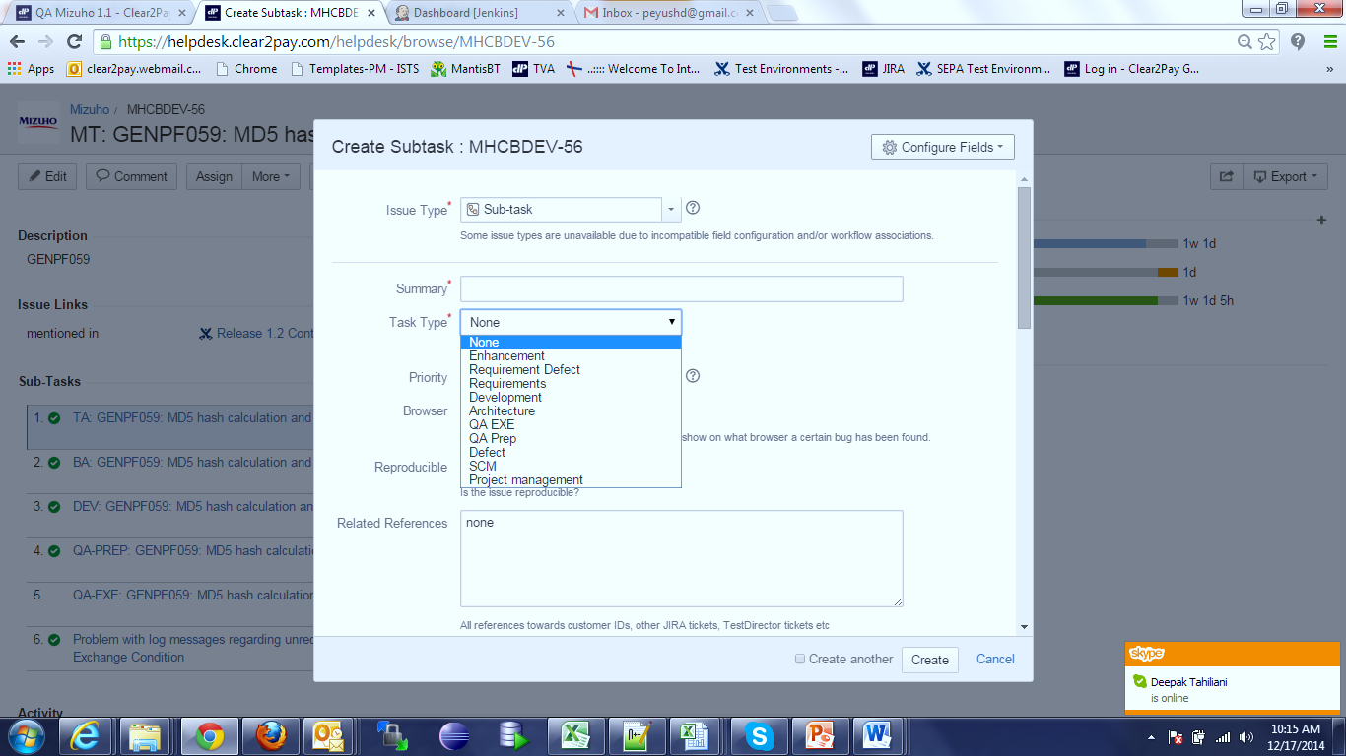
QA-EXE JIRA
The above task are created by respective Leads in all the projects. In order to create a sub-task, open the Main task in JIRA, Click on more – Create Sub-task and following screen will come up. For QA EXE task, we have to select Task Type as QA EXE

Slide 63
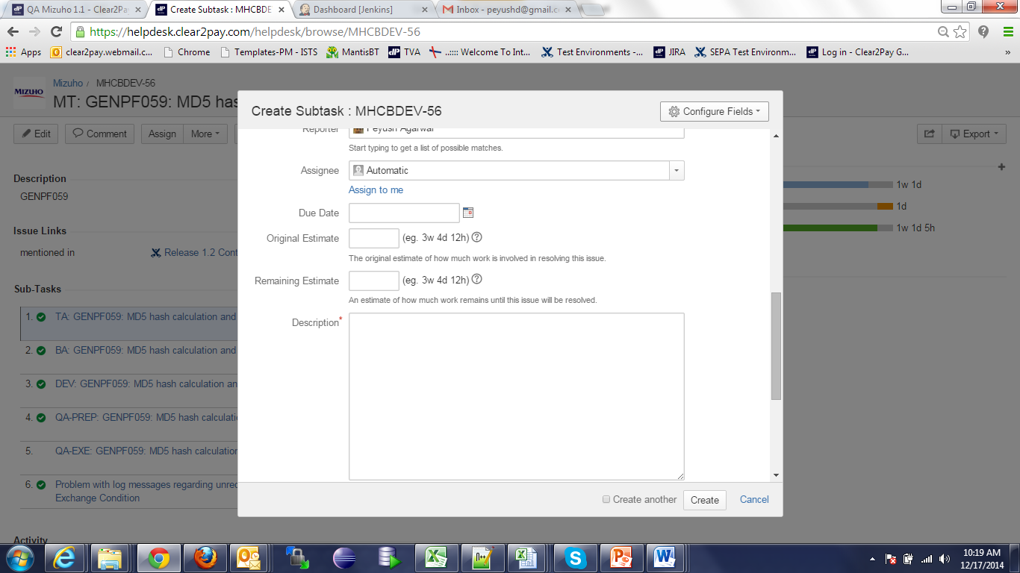
JIRA and different QA Task States
While creating the sub-task for Prep or Exe, we need to enter Original Estimate value which can be taken from Project Estimate sheet or form the Change Request document.

Slide 64
QA Prep Task States
Once the Prep and Exe Sub task are created, we need to move the status of Task. The various stages involved of QA-Prep is shown below and Exe task (next slide). Resource needs to move the stage of Task once assigned by TL.
New
Open
In progress
Review
Closed

Slide 65
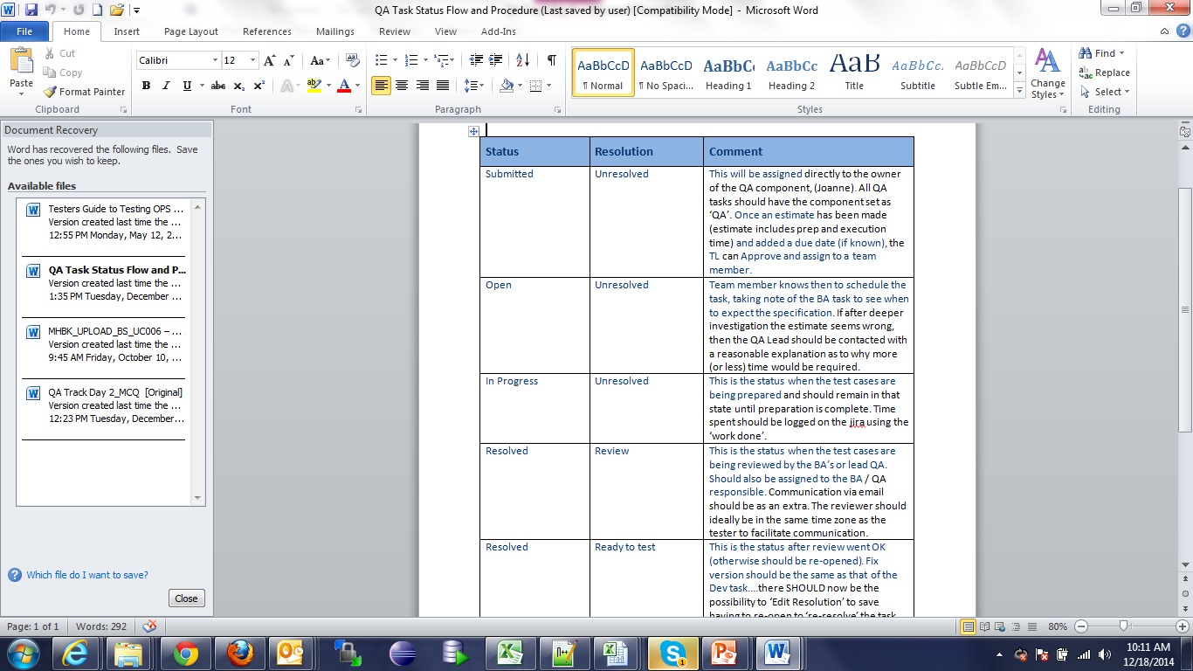
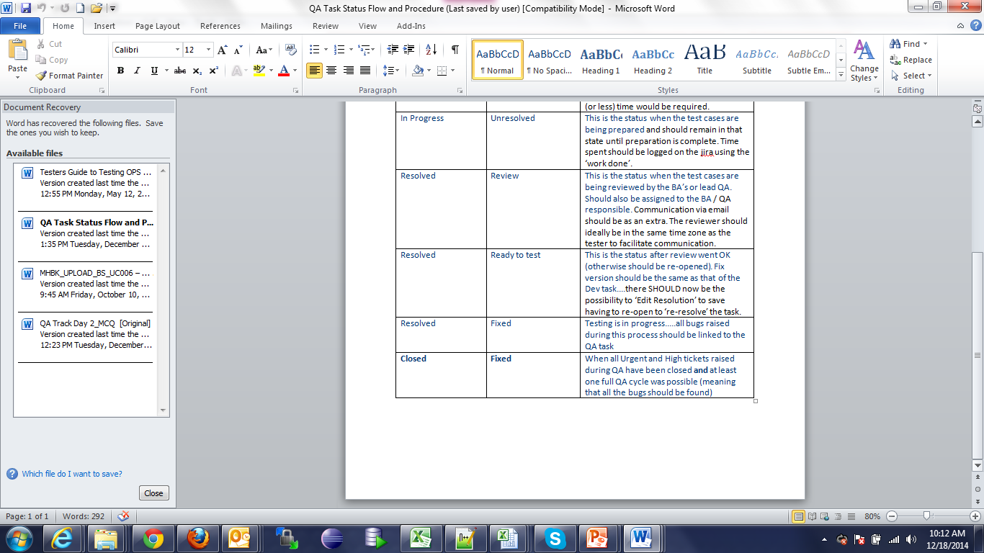
JIRA and different QA Task States
Below is the snapshot of brief description of various stages of Sub-Task:

Slide 66
QA EXE Task States
The various stages involved for QA Exe task is shown below. Resource needs to move the stage of Task once assigned by TL.
New
Open
In progress
Closed

Slide 67
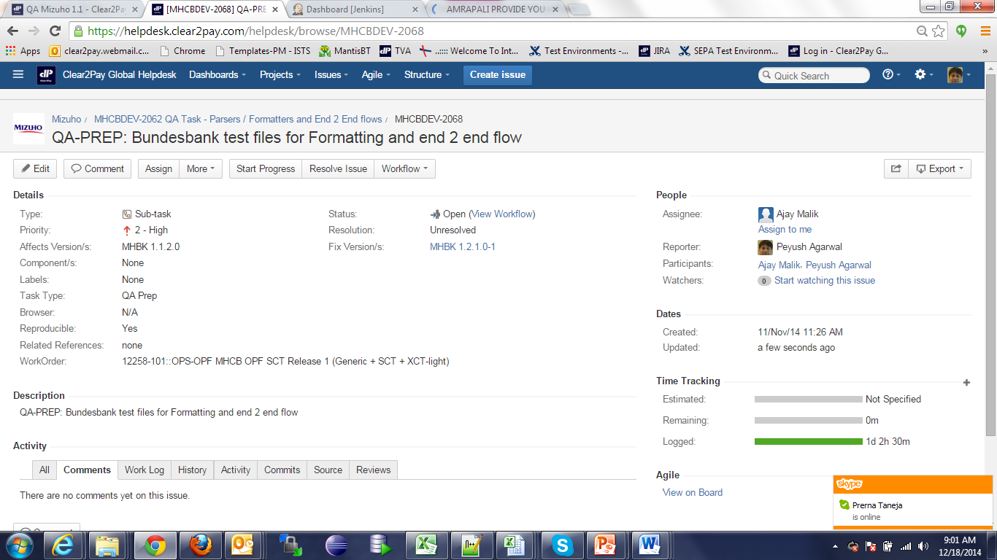
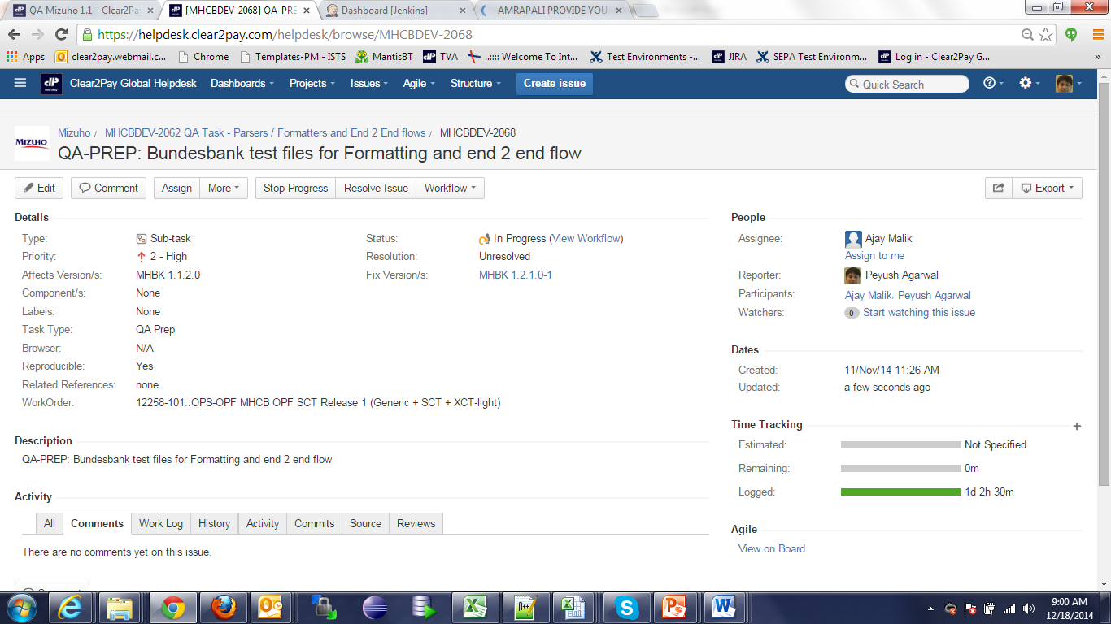
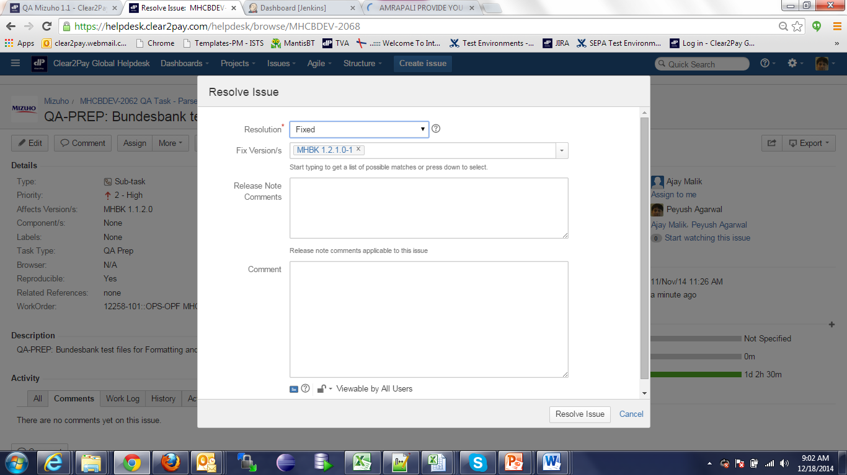
JIRA and different QA Task States
Once the Prep and Exe Sub task are created, we need to move the status of Task as shown below. Resource needs to move the stage of Prep Task once assigned by TL.
Click on Start Progress to move the status to “In Progress”
Click on Resolve Issue and following window will be displayed
Click on Stop Progress to move the status to “Open”
Select “Review” and status will be changed for Review

Slide 68
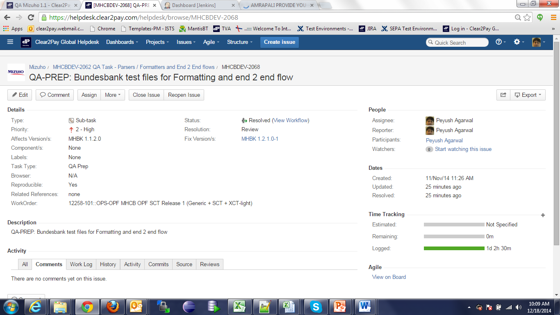
Closure of QA Task
Once the Prep and Exe Sub task are created, we need to move the status of Task as shown below. Resource needs to move the stage of Prep Task once assigned by TL.
Click on Close to move the status to “Close Issue” after Review comments have been incorporated

Slide 69
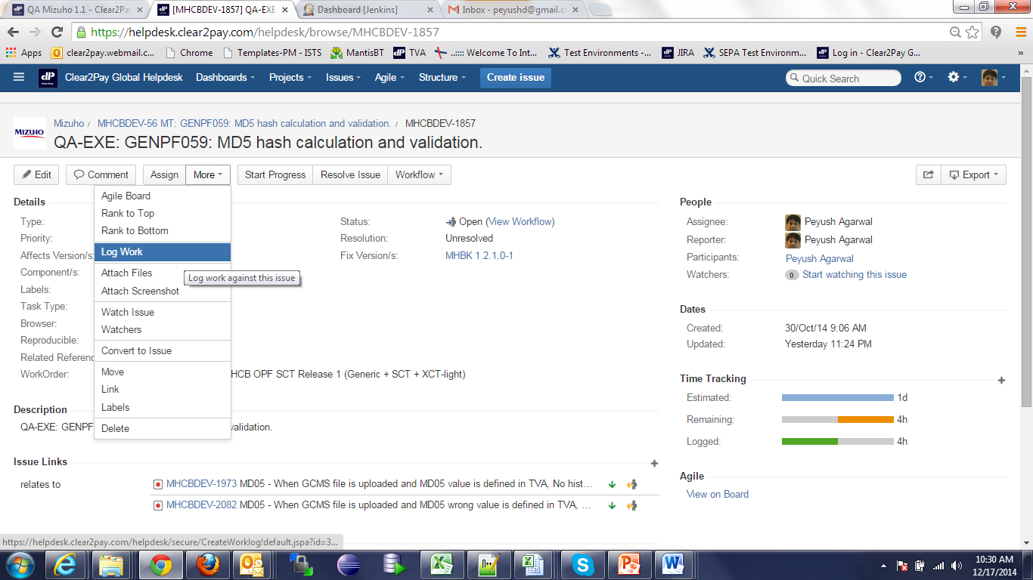
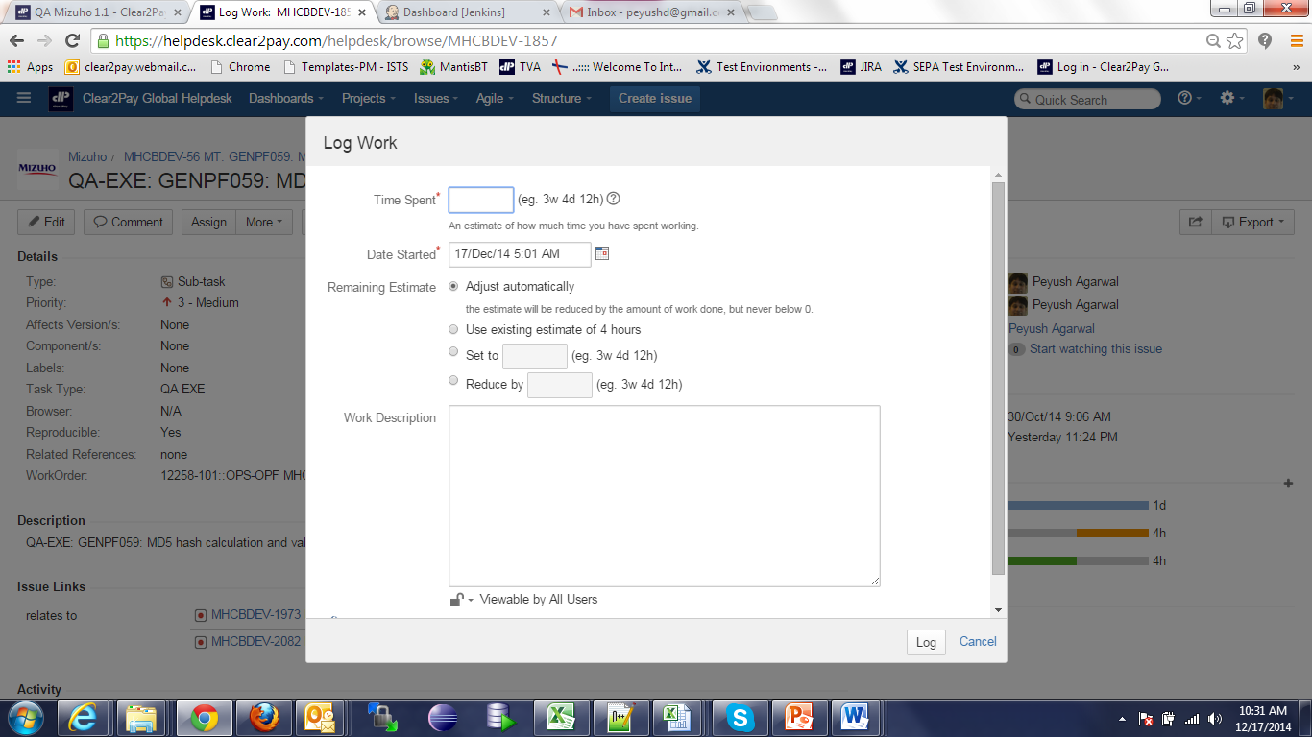
How to Log hours in JIRA
The above activity has to be done for all Project features for which Main task exists.
All resources are expected to fill the hrs. in JIRA for Prep and Exe QA sub-task on daily basis.
First snapshot below is when we click on more – Log work and second snapshot shows where we can enter time and log the efforts.

Slide 70
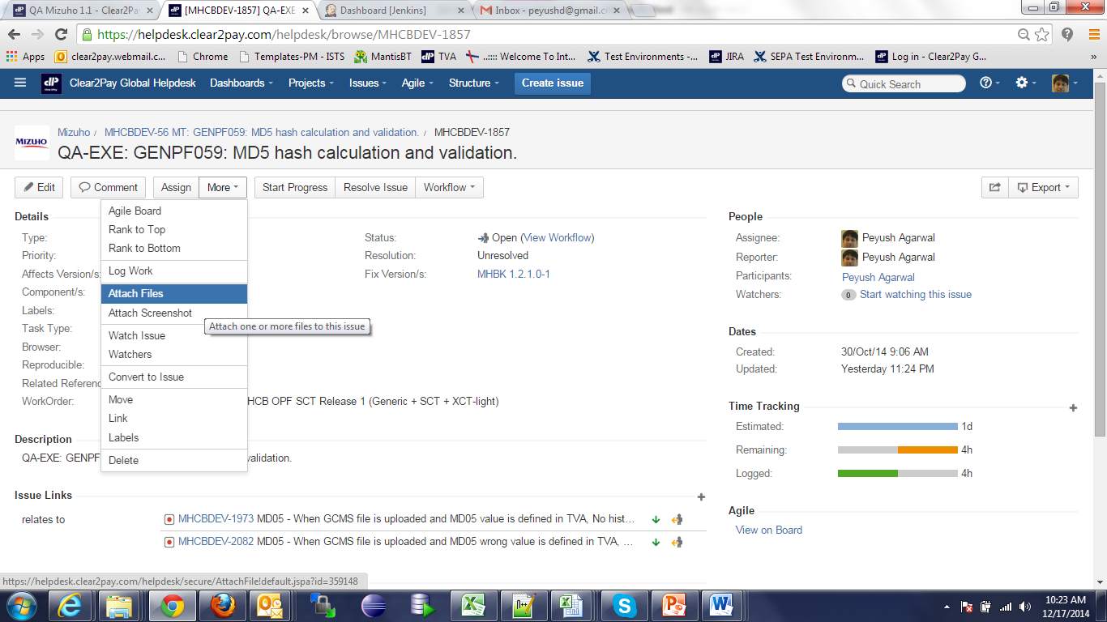
Linking of Defects with QA EXE Task
For QA Exe sub-task, all the defects that are logged during execution need to be linked to QA Exe task. Below is the snapshot on how to link the defects. Suppose a JIRA # MHCBDEV-100 is raised. Click on More - Link

Slide 71
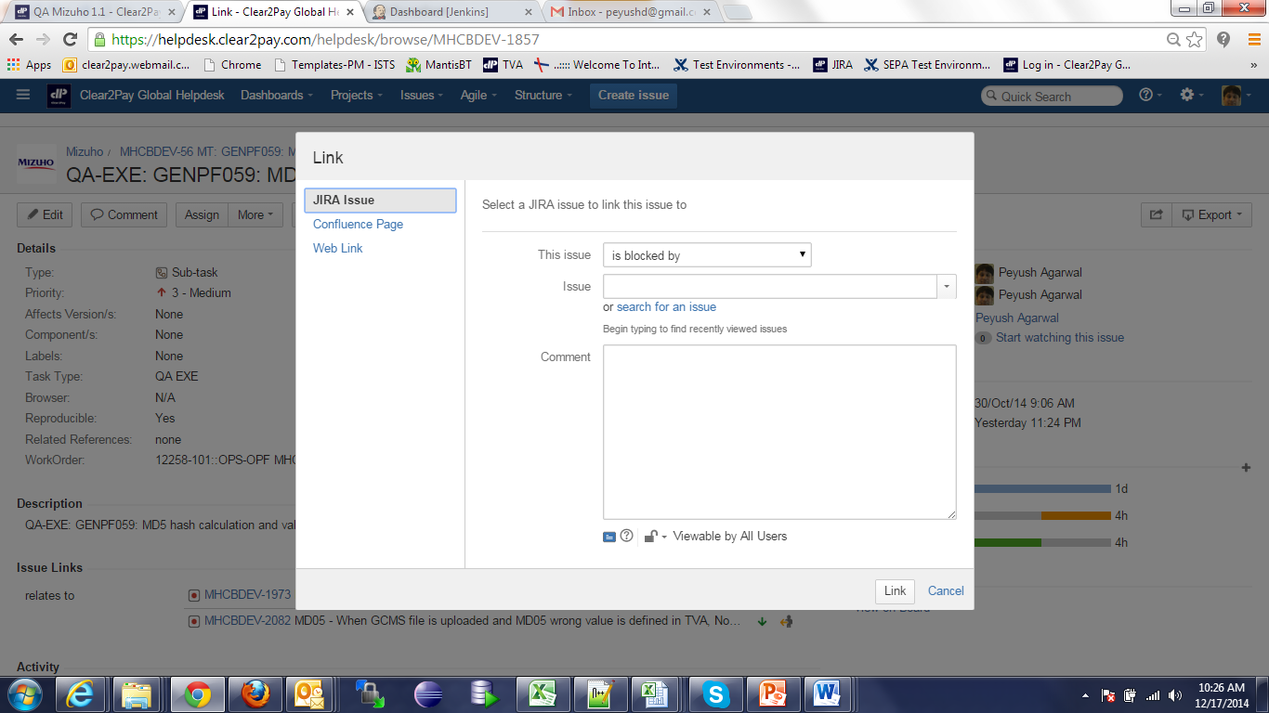

Linking of Defects in EXE Task
After clicking on Link, following screen should be displayed. Tester needs to select relevant stage from “This issue”, and enter MHCBDEV-100 in Issue. Put any comment land click on Link. It will display in QA Exe as shown in the snapshot below under Issue Links.

Slide 72

QA Guidelines
Following are the snapshots of QA Guidelines

Slide 73

QA Guidelines

Slide 74

QA Guidelines

Slide 75
Bug Logging Guidelines
Tester can click on Create Issue to log a defect. Snapshots are shown in next slide but before that lets go through fields that need to be filled in by Testers:
Summary – A high level 1 liner description
Task Type – Defect
Severity – Depending on the defect
Priority – Depending on the defect
Related Reference – Any Use Case Reference, TC Number, any other document reference
Components – if it is Parser, Tester can select Parser
Affects version – depends on which version is Project on.
Description – Steps to reproduce, Actual and Expected Result and reference of attached files.
Assignee – Normally would be Dev Lead.
Work Order – Project Work order
System Logs

Slide 76



Bug Logging Guidelines

Slide 77

Bug Life Cycle
Following Bug Life Cycle to be followed in JIRA:

Slide 78
Revision
JIRA Structure
How to create QA Prep Task
How to create QA Exe Task
States of QA Prep and Exe Task
Linking of Defects with QA Exe Task
Bug Logging guidelines
Bug Life Cycle
4 types of Task (BA, DEV, QA Prep and Exe and TA)
Select QA Prep while creating sub task
Select QA Exe while creating sub task
How to change Task from one state to another
Important fields to be filled while reporting defect
How to link defect with QA Exe Task for monitoring
Change States from New to Close for Prep and Exe Task
New, Open, In Progress, Review, Closed

Slide 79
C2P India
QA Track – Day 6 and 7
SPIRA

Slide 80
TABLE OF CONTENTS
1
Add- Ins
2
Overview
3
Release/Iteration
4
Requirement
5
Test Sets
6
Test Cases /Folder creation
7
Custom Fields
6
Custom Fields
8
Test Case Execution
9
Test Run
10
Reporting

Slide 81
Overview
SpiraTest manages your project's requirements, tests, bugs and issues in one environment, with complete traceability from inception to completion.
Manage requirements, features and use-cases
Create, edit and execute test-cases
Track bugs, enhancements, risks and issues
Map tests to requirements to track coverage
Clean and powerful user interface
Support for template test cases
Link bugs to test steps during test execution
Drill down from requirements to tests and incidents
Personalized dashboards and customizable reporting
Web-based graphs and reports

Slide 82

Overview
Each project has a dashboard home-page that summarizes all of the information regarding the project into a comprehensive, easily digestible form.
It provides a “one-stop-shop” for people interested in understanding the overall status and health of the project at a glance.

Slide 83

Add-Ins
Go to Inflectra web site (http://www.inflectra.com/SpiraTest/Downloads.aspx) and download/Install Spira Test MS-Office 2007 add-in.
Test Cases Template can be downloaded: https://svn-mec.clear2pay.com/svn/repos/rd/core/OPF/trunk/doc/QA/Documentation/SpiraImportTemplate.xlsm
In excel Add Ins tab should be visible where the user will be connected to the project.

Slide 84

Release/Iteration
In Spira Navigate to Planning->Release.
Insert a Release/Iteration on Project basis.

Slide 85

Requirement
In Spira Navigate to Planning->Requirement. Create a Requirement per Project feature/Use Case/Importance/Release/Type

Slide 86

Requirement
Each requirement is mapped to one or more test cases that can be used to validate that the functionality works as expected.

Slide 87


Test Sets
Navigate to Testing>Test Sets. Create a Test Set per Requirement.
Map Test Cases to Test Set using Add Tests link.

Slide 88
Custom Fields
All Custom fields can be filled in by using a dropdown menu pointing to the related section under the lookup tab.
Dropdown lists will allow the user to select ‘simple’ or ‘complex’ instead of 821, 822…
2 buttons are added into lookup sheet allowing the user to switch from a version ‘Ready to be exported’ to a ‘User Friendly’ version and vice-versa.
Cutom drop down field values needs to be added in Spira.
Custom field values in look up tab in excel needs to be taken from Spira Project.

Slide 89




Custom Fields
Custom fields in Test Case/Look Ups Tab
Spira->Administration-> Custom Properties

Slide 90
Test Cases /Folder creation
Click on Add-In menu, Connect to Spira by providing correct URL and user credentials.
Write test cases, define folders, sub-folders. To create sub-folders, remember to use the increase indent option (Ctrl + Alt + Tab) and the correct option in “Type” column of “Test Cases” tab.
To import to Spira, click the export button in excel add-in menu. The sheet gets updated with IDs of test folders / test cases / test steps.
Add Requirement ID, Release ID, Test Set ID from Spira into excel(Column F,G,H respectively).

Slide 91


Test Cases /Folder creation
Test Cases/Folder in Excel
Test Cases/Folder in Spira

Slide 92

Test Cases /Folder creation
Each test case consists of a set of test steps that represent the individual actions a user must take to complete the test.
You can include other template test cases as steps within your test case. This allows you to build a library of reusable test components.

Slide 93


Test Case Execution
From Test Set Select and Execute the TC
Pass/Fail/Block the TC after execution. Add Results/Data/attachments

Slide 94

Test Case Execution
You can execute groups of test cases - along with their test steps – so that the testers can follow the instructions and determine if the system being tested behaves as expected. Optionally a new incident can be raised in the system – linked to the test step failure

Slide 95

Test Run
Every time you execute a test case, SpiraTest records every pass / failure as well as the associated incidents generated as a ‘Test Run’. These archived Test Runs can be viewed to determine if changes to the system have introduced failures to previously working functionality.

Slide 96
Reporting
Navigate to Reporting-> Create report.
User has an option to create report for requirements, test cases, incidents and releases
Select values in Standard field filters as per the requirement and generate the report.
User also has an option to generate various graphs for Requirement, Test Cases.
Report can be generated in various formats like MS word, Excel , Adobe Acrobat PDF,etc.

Slide 97


Reporting
Reporting options
Select the appropriate Report/Format

Slide 98

Reporting
SpiraTest includes an extensive reports library that can display information such as Requirements Coverage, Test Case Execution, and Incident Status.
SpiraTest allows you to build a customized reporting dashboard featuring your frequently-used graphs, charts and reports.
The graphs available include: Requirements Coverage, Test Run Progress, Incident Discovery Rate, Cumulative Artifact Counts

Slide 99
C2P India
QA Track – Day 8
OPF/XCT – Overview

Slide 100
Agenda
OPF/XCT - View from Testers Perspective
Question and Answers
Services

Slide 101

OPF / XCT Architecture
XCT
OPF

Slide 102

OPF & XCT
xCT
OPF

Slide 103







OPF Testers View – A Case Study (On Us Payment)
MT103 (50 EUR)
MT103 (50 EUR)
Mr. Edward
Debit Party
Barclays, UK (BARCGB22)
Debit Party Agent
Mrs. Elaine
Credit Party
XCT BANK-1, Belgium
(XCTABEBB)
Credit Party Agent
Mr. Edward wants to transfer 50 EURO to Mrs. Elaine.
Mr. Edward have an Account at Barclays Bank while Mrs. Elaine have an Account at XCT Bank -1.
Mr. Edward initiates a Payment via Mobile Banking, Internet Banking or Cheque Transfer.
Barclays Bank process the request from Mr. Edward while debiting his account with 50 Euro and crediting 50 Euro in its Internal Account.
Barclays Bank, to narrate this whole story, creates & send a message MT103 over SwiftGateway.
From its Internal Account, Barclays Bank transfers the amount in XCT Bank -1’s Vostro Account at Barclays Bank.
SwiftGateway validate the file and forward it to be received by XCT- Bank-1.

Slide 104

Sample Payment message MT File.
Above is sample payment *.txt file (a Swift MT payment) that would enter into the bank application where XCT is implemented.

Slide 105
Services
Interchange Loader
Parser & Formatter
Duplicate check
Worklist Item
4Eye Verification

Slide 106
Services
Interchange Loader
Parser & Formatter
Duplicate check
Worklist Item
4Eye Verification

Slide 107
Interchange Loader (1)
Interchange Loader
Purpose is to provide a means to load raw payment related data from a channel:
Creates an Interchange
Stores “transport data”
Determines the: Bank Group, Bank and incoming Clearing Condition
Once raw data has been captured completely the Interchange Loader can notify, asynchronously, an implementation of the Parsing Service
If during Interchange loader process anything goes wrong:
The system cannot send a NAK message, since the content of the message is not even read
A ‘technical alert/error’ can be logged, which can be captured by alert systems like Tivoli.

Slide 108
Interchange Loader (2)
Interchange Loader
Two “flavours”:
Meta data (Bank group, Bank, Exchange condition) provided along with the message or file (i.e. Interchange loader used to load SWIFT MX messages in xCT like PAIN.001.xml) .
Meta data derived from the message or file (i.e. Interchange loader used to load SWIFT MT messages in xCT like MT103.txt)

Slide 109

Interchange Loader (3)
Receiver
Sender

Slide 110
Services
Interchange Loader
Parser & Formatter
Duplicate check
Worklist Item
4Eye Verification

Slide 111
Parser
Parser
Component which reads a message’s raw data, transforms it and retains it in the OPF internal data model
Upon failure of the parser, the complete interchange will be rejected:
Since the interpretation of the message failed, the already read data is not trustworthy.
Makes it difficult to reply in an automated way.
A ‘technical alert/error’ can be logged, which can be captured by alert systems like Tivoli.
Formatter
Component which reads the relevant data from the OPF internal data model, transforms it and creates a message
Part of the submission framework:
The submission service will create an outgoing Instruction (optionally) and Interchange and will enrich these entities
The formatter creates an outgoing message based on the Transaction, outgoing Instruction and outgoing Interchange

Slide 112
Services
Interchange Loader
Parser & Formatter
Duplicate check
Worklist Item
4Eye Verification

Slide 113
Possible Duplicate Check (1)
Possible duplicate check
Validation on certain attributes revealing Instructions that are possibly duplicates of Instructions that are already existing in the system:
Having the same incoming Clearing Condition
Within a configurable time range
The attributes are configurable
An issue is raised upon detection of a possible duplicate Instruction
Outcome can be Instruction approval, other outcomes are possible too (e.g. Reject)

Slide 114
Possible duplicate check (2)

Slide 115
Services
Interchange Loader
Parser & Formatter
Duplicate check
Worklist Item
4Eye Verification

Slide 116

WorkList Item
A work List Item is a functionality in OPF that enables a bank user to act on a payment which is in status that requires a manual action (like approval, rejection, repair, 4-EV etc..)

Slide 117
Services
Interchange Loader
Parser & Formatter
Duplicate check
Worklist Item
4Eye Verification

Slide 118

4 - Eye Verification (1)
A 4-Eye Verification is a service in OPF that enables a bank user to approve/decline a previously taken action on a payment done by another bank user.

Slide 119

4 - Eye Verification (2)

Slide 120
What you should Know after this?
What is OPF & XCT and how they are related ?
How a Payment Flows through different channels ?
What are different Services in OPF & XCT ?

Slide 121
C2P India
QA Track – Day 9
TVA/BVA Overview & Hands-On

Slide 122
Agenda
TVA – Overview & Walkthroughs
Question and Answers
BVA – Overview & Walkthroughs

Slide 123
Agenda
TVA – Overview & Walkthroughs
Question and Answers
BVA – Overview & Walkthroughs

Slide 124
OPF Testers View – A Case Study (On Us Payment)
MT103 (50 EUR)
MT103 (50 EUR)
Mr. Edward
Debit Party
Barclays, UK (BARCGB22)
Debit Party Agent
Mrs. Elaine
Credit Party
XCT BANK-1, Belgium
(XCTABEBB)
Credit Party Agent
Mr. Edward wants to transfer 50 EURO to Mrs. Elaine.
Mr. Edward have an Account at Barclays Bank while Mrs. Elaine have an Account at XCT Bank -1.
Mr. Edward initiates a Payment via Mobile Banking, Internet Banking or Cheque Transfer.
Barclays Bank process the request from Mr. Edward while debiting his account with 50 Euro and crediting 50 Euro in its Internal Account.
Barclays Bank, to narrate this whole story, creates & send a message MT103 over SwiftGateway.
From its Internal Account, Barclays Bank transfers the amount in XCT Bank -1’s Vostro Account at Barclays Bank.
SwiftGateway validate the file and forward it to be received by XCT- Bank-1.

Slide 125

TVA - Test Visibility Application
MT103 (50 EUR)
TVA
XCT BANK-1, Belgium
(XCTABEBB)
Credit Party Agent
TVA is a Test Driver which allow a tester to exercise/examine in a controlling manner the unit of software being tested (in this case the Bank Visibility Application)
Thus we can call it as an entry point which mimics the behavior of real environment to allow the Payment message file to be entered in the system for processing.

Slide 126

TVA - User Interface

Slide 127
TVA - Frequetly Used Functionalities
Post Swift Interchange Form
Post Interchange Form
Alter system time
Endorsement
Config View
Flow Logger

Slide 128
TVA - Test Visibility Application
MT Swift Format (*.txt)
ISO Format (*.xml)
Proprietary
Gateway
TSV Format (*.tsv)
TVA
The incoming file from the payment governing body towards bank can be of different types:-
MT Swift Format (*.txt)
ISO - 20022 Format (*.xml)
Proprietary Format (*.tsv)

Slide 129


TVA - Post Swift Interchange Form
The PostSwiftInterchangeForm is used for uploading the Swift MT (*.txt) type messages into the system.
Origin - From Swift (so as to reflect that the payment is coming ‘From Swift’).
Browse and select the file (may be lying locally).
Post Count/ Post Rate/ Randomization - They can be kept unchanged as they are only useful for advanced Non Functional Tests.
Submit - It will place the incoming file in the queue to be further processed by the system.

Slide 130


TVA - Post Interchange Form (1)
The PostInterchangeForm option is used for uploading the Swift ISO / MX (*.xml) type messages.
Bank Name - Accepts the name of receiving bank, mentioned in the Payment file.
Bank Group Id - Accepts the BankGroup name of receiving bank.
Since OPF can be configured as a multibank / multi bank group environment, we need to indicate both the bank group (Bank Group Id) and the bank (Bank Name). The combination of the two parameters tells exactly which bank to use to process the file.

Slide 131
TVA - Post Interchange Form (2)
Exchange ID - An Exchange Condition contains information about the clearing process and exchange of information between the OPF Bank and one of the Participants it interacts with.
File - Browse and select the file (may be lying locally).
Submit - It will place the incoming file in the queue to be further processed by the system.

Slide 132


TVA - Alter System Time
It is a function that changes the date on the test application server, used to advance or go back in time.
This enables user to test functionalities, for e.g. De-Warehousing, Time Line Validations.
Tests where rather than waiting for days (or even months and years) for the correct time-lapse, it is possible to test on the same day (or even possible in the case of tests that require significant timescales).

Slide 133

TVA - Endorsement On/Off
At certain point of time it is required to Add/Edit/Delete some part of the configuration of the bank application, like adding New Bank User, Modifying new participant, etc...
These are critical functionalities from a bank set up perspective and thus can not be added just by one person on a go and would require discretion of an authorized person.
If the Endorsement is ON then any configured change in BVA that requires to be endorsed should be approved/endorsed by another Authorized entity.
Default value for Endorsement is set as True, while a new build is arrived, but can be turned on through TVA, or can be defaulted to False by implementation team.

Slide 134


TVA - Deep Sea (Configuration View)
This functionality is to help tester to refer/view the content of the various configuration files that are a part of the application.

Slide 135


Deep Sea – Flow Logger
This is used to see the real time logs that are being recorded while an activity is performed over the application.
For e.g. to see any unexpected behavior while a service is being invoked.

Slide 136
Agenda
TVA – Overview & Walkthroughs
Question and Answers
BVA – Overview & Walkthroughs

Slide 137
BVA - Bank Visibility Application (1)
BVA
The Bank Visibility Application (BVA) is a web-based platform that provides an end-to-end environment for electronic payments used with OPF. BVA provides functionality to Bank Users to, amongst other things:
- Setup and maintain Bank information including:
Banks and Departments
Users
Bank User Accounts, Bank User Roles
Routing Rules …
- Manage Payments including:
Search and view Interchanges, Instructions and Transactions
View Work list Items
View Audit Logs
User Interface to Create/Repair/Approve Payments …

Slide 138


BVA - Bank Visibility Application (2)
Pass
BVA
Interchange Loader
Look for errors in System logs
TVA
Fail
BVA is a visual representation of the application.
The services that a payment message undergoes, before it finally comes into the system is Interchange Loader .
Before a message content can actually be visualized in BVA, a successful result from these services should happen.
If a failure happens then the underlying reason can only be seen in the System Error Logs. So if you upload a file & you don’t find it in BVA, then you should go to System Logs to verify the root cause of failure (which is actually Invalid File).

Slide 139


BVA - UI (Login Screen)

Slide 140

BVA - UI (Interchange Search Screen)
This screen enables a user to search interchanges in the system.
Drill down to the underlying instruction and Transaction details.
Sort them on basis of various columns displayed on screen.
Navigate through pages if interchange count exceed then 15.
Save a searched query for a later use.

Slide 141

BVA - UI (Instruction Search Screen)
This screen enables a user to search Instructions in the system.
Drill down to the underlying Transaction details.
Sort them on basis of various columns displayed on screen.
Navigate through pages if interchange count exceed then 15.
Save a searched query for a later use.

Slide 142

BVA - UI (Transaction Search Screen)
This screen enables a user to search Instructions in the system.
Drill down to the underlying Transaction details.
Sort them on basis of various columns displayed on screen.
Navigate through pages if interchange count exceed then 15.
Save a searched query for a later use.

Slide 143

BVA - UI (Manual Entry Screen)
This screen gives the Bank User, a way to create a payment which could be of
MT103 or MT202 ….
Credit Transfer or Financial Institution Credit Transfer.
…Or any other type of Payment messages that the implementation team supports.

Slide 144
Hands On Exercise
TVA Hands On:
Post Swift Interchange Form (MT103)
Config View
Flow Logger
Alter System Time
Toggling Endorsement
Refer the Hands on Excercise File for TVA.
BVA Hands On:
Search and view Interchanges, Instructions and Transactions (MT103)
View Audit Logs
Manual Entry (MT103)
Bank Users
Participants
Refer the Hands on Excercise File for BVA.

Slide 145
C2P India
QA Track – Day 10
Test Data Understanding & Hands-On

Slide 146
Agenda
Test Data Understanding
Question and Answers
Walkthrough's

Slide 147
Agenda
Test Data Understanding
Question and Answers
Walkthrough's

Slide 148
Payment Message Formats
MT Format (*.txt)
ISO Format (*.xml)
Proprietary
Gateway
TSV Format (*.tsv)
TVA
The incoming file from the payment governing body towards bank can be of different types:-
MT Swift Format (*.txt)
ISO - 20022 Format (*.xml)
Proprietary Format (*.tsv)

Slide 149
SWIFT & SWIFT Formats
SWIFT stands for Society for Worldwide InterBank Financial Telecommunications.
An automated payment system used to transfer funds between different countries.
SWIFT is
A cooperative organization created and owned by banks which operates a network to facilitate the exchange of payment and other financial messages between financial institutions throughout the world.
A messaging network. Note that SWIFT does NOT move any money.
The most widely used Financial Network on the planet
Two different message standards
MT (Text Format)
MX (XML Format)

Slide 150
SWIFT MT – Header Block Information
Any SWIFT MT message is confined in 5 different Blocks.
SWIFT MT Headers
Application Header
User Header
Text /Body
Trailer
Basic Header

Slide 151
Sample SWIFT MT Message
{1:F01XCTABEBBAXXX1822765812}
{2:O1031235141209BARCGB22KTRD18850565201412091235N}
{3:{113:URGT}}
{4:
:20:UniqueRefa
:23B:CRED
:32A:141219EUR50,00
:33B:EUR50,00
:50F:/1234567
1/Mr Edward
2/RUE JOSEPH II, 19
3/CH/1044/Geneva
:57:XCTABEBB
:59:/321567
Mrs Elaine
555, S. FLOWER STREET
BE/Brussels/3006
:71A:SHA
-}
{5:{PDE:100510WDCMESESDXXX0987654321}{PDM:100510XCTABEBBAXXX1234567890}}
Basic Header Block
Application Header Block
User Header Block
Text Block or body
Trailer Block

Slide 152

SWIFT MT Format
A Minimal MT Swift Format (MT103.txt)
Receiving Party
Sending Party
Unique Reference Id
Message Priority
Settlement Date, Settlement Currency & Amount
Debit Party Information
Credit Party Agent
Credit Party Information
Above is sample payment MT103.txt file (a Swift MT payment) that would enter into the bank application.

Slide 153

Validate your Swift messages
A utility that you can use to validate your SWIFT Message file.
Navigate to the Web Page http://mds.c24io.net/validate/swift
Select appropriate SWIFT Standard to validate.
Enter a SWIFT message into the text box
Accept the Terms of Usage.
Click on the Validate.
To demonstrate the functionality, sample valid and invalid messages are provided.
In the example here, 33B is required but was not in the file, thus the Validation error is thrown by the utility.
This utility is available with a Disclaimer. But is best available as of now.

Slide 154
Agenda
Test Data Understanding
Question and Answers
Walkthrough’s

Slide 155
Walkthrough's
Walkthrough of the real MT103 Sample File
Walkthrough of the SWIFT reference guide. e.g. MT103.
Walkthrough of the different options that can be used for a particular tag. E.g. tag 57 in MT103 payment message can be populated with either of options A, B, C, or D.

Slide 156


Walkthrough's
Sample Interchange
Different options for tag 57 for MT103

Slide 157
What you should know after this?
What is SWIFT Message?
Different information blocks of a SWIFT message.
Data Definition for Various components of a SWIFT message.
Validating your SWIFT message.
Understanding Swift reference guide.

Slide 158
C2P India
QA Track – Day 11,12,13,14
Interchange Loader, Walkthrough's & Exercise

Slide 159
Agenda
Loader
Question and Answers
Walkthrough's
Exercise

Slide 160
Agenda
Loader
Question and Answers
Walkthrough’s
Exercise

Slide 161

Interchange Loader
New payment File
New payment File
TVA
System Queue
Interchange
Loader
A new file from a payment gateway comes into the system.
TVA, being a driver, puts the message onto a System Queue. Messages are received from one or more queues that the host bank uses to receive payments messages from different Participants.
First Service that keeps listening for the payment message is interchange Loader.

Slide 162
Interchange Loader
Interchange Loader Service :-
Loads an Payment Interchange message from a queue.
Verify that the message file Block 1 contains a Bank Name, matching a Bank stored in the system.
Store the payment as an Interchange record in the system. i.e. the payment can Interchange can now be seen in BVA. No matter what validation failure happens next.
The IC Load service then places the Interchange message onto the Parsing Service queue.

Slide 163
Agenda
Loader
Question and Answers
Walkthrough's
Exercise

Slide 164
Interchange Loader – Walkthrough's
Walkthrough's
Use Case walkthrough - XCT_ICLOAD_BS_UC001 – Load and Store an Interchange.
Sample Test Case Walkthrough for the above use case.
Walkthrough of the referenced/supporting documents in above use case.
OPF_ICLOAD_BS_UC001 - Load and Store an Interchange
OPF/XCT - History Audit WLI and BVA Messages.xlsx

Slide 165
Agenda
Loader
Question and Answers
Walkthrough's
Exercise

Slide 166
Interchange Loader – Exercise Day 1
Exercise Day 1
A Jira prep/exe task would be assigned to each of participant in this room.
Write all the possible test cases for all the flows for Use Case (XCT_ICLOAD_BS_UC001 – Load and Store an Interchange) while making sure you follow the test case writing checklist. (Use Test Case writing Excel Template).
Update Jira status as per the Testing procedure and workflow explained in earlier individual sessions.
Once done with writing Test Cases, commit them in SVN.
Add the SVN location of Test cases in Jira and send the test cases for review.
Do a peer review for the test cases written by others (assigned to you).
Incorporate Review feedback received for your test cases and send it for BA Review. (available BA’s List would be provided).
Incorporate BA’s Feedback comments.
Note:- Make sure to follow all the process for Spira, Jira, TC checklist that have been discussed in previous sessions.

Slide 167
Interchange Loader – Exercise Day 2
Exercise Day 2
Upload the test cases on Spira.
Map the test cases with the requirements in Spira
Create a test Set and Map the test cases with it and mention the test set URL info on the QA EXE Jira task.
Start Executing the test cases using test set against a release in Spira.
Log the bugs in Jira while you execute the test cases and link them with the prep/Exe task with their proper dependency/relation with the task.
Update the Jira task status as per workflow.
Record results with execution screenshots wherever applicable (in .doc format).

Slide 168
What you should Know after this?
What is Interchange Loader Service?
Understanding Message Entry/Loading into System.
Outcome of Interchange Loader Service Flow.
End to End Test Process followed in OPF Product or projects based of OPF.

Slide 169
C2P India
QA Track – Day 15,16,17
Parser & Walkthrough's

Slide 170
Agenda
Question and Answers
Walkthrough's
Parsers
Exercise

Slide 171
Agenda
Parsers
Question and Answers
Walkthrough's
Exercise

Slide 172
Parsers
Interchange Loader
Parsing
System Queue
Once an interchange is created, then the raw content of the payment file is read and is then transformed and retained in the OPF internal data model.
Various attributes of the Payment Messages are then determined from that raw content.For e.g.
Classification.
Settlement Date
Settlement Amount
Settlement currency
This is when going forward Instructions and Transactions are created.

Slide 173
Parsers
Parser
Its a service which reads a message’s raw data, transforms it and retains it in the OPF internal data model.
or Creation & Storage of all Instructions and Transactions that are derived from the Interchange.
Upon failure of the parser, the complete interchange will be rejected:
Since the interpretation of the message failed, the already read data is not trustworthy.
Makes it difficult to reply in an automated way.
A ‘technical alert/error’ can be logged, which can be captured by alert systems like Tivoli.

Slide 174
Parsers
Interchange Parser Service :-
Determines the format of the Interchange.
Creates the Instruction and Transaction.
Enrich the created Instruction/Transaction.

Slide 175
Recap - Loader / Parsers Service.

Slide 176
Agenda
Parsers
Question and Answers
Walkthrough's
Exercise

Slide 177
Parsers– Walkthrough's
Walkthrough's
Use Case walkthrough - XCT_PARSER_BS_UC001_Interchange Parser Service
Walkthrough of the OPF referenced documents in above use case.
Walkthrough of the parser document ../Data Mapping/11.8.2/XCT - ME - SWIFT Parser Mapping (MT103).xls.
Understanding the functions used in parser document.
Sample Test Case Walkthrough for the above use case.

Slide 178
Agenda
Parsers
Question and Answers
Walkthrough's
Exercise

Slide 179
Parsers – Exercise Day 1
Exercise Day 1
A Jira prep/exe task would be assigned to each of participant in this room.
Write all the possible test cases for all the flows for Use Case (XCT_PARSER_BS_UC001_Interchange Parser Service) while making sure you follow the test case writing checklist. (Use Test Case writing Excel Template).
Look Back to refer to the OPF Use case (OPF_PARSER_BS_UC001_Interchange Parser Service)
Update Jira status as per the Testing procedure and workflow explained in earlier individual sessions.
Once done with writing Test Cases, commit them in SVN.
Add the SVN location of Test cases in Jira and send the test cases for review.
Do a peer review for the test cases written by others (assigned to you).
Incorporate Review feedback received for your test cases and send it for BA Review. (available BA’s List would be provided).
Incorporate BA’s Feedback comments.

Slide 180
Parsers – Exercise Day 2
Exercise Day 2
Upload the test cases on Spira.
Map the test cases with the requirements in Spira
Create a test Set and Map the test cases with it and mention the test set URL info on the QA EXE Jira task.
Start Executing the test cases using test set against a release in Spira.
Log the bugs in Jira while you execute the test cases and link them with the prep/Exe task with their proper dependency/relation with the task.
Update the Jira task status as per workflow.

Slide 181
What you should Know after this?
What is parser service?
Understanding different type of message parser.
Understanding different functions used in parsing.
Outcome of parser service flow.
End to End Test Process followed in OPF Product or projects based of OPF.

Slide 182
C2P India
QA Track – Day 18,19
Validations and Issue Processor

Slide 183
Agenda
Validation Framework
Question and Answers
Issue Processor Framework

Slide 184
Agenda
Validation Framework
Question and Answers
Issue Processor Framework

Slide 185
Validation Framework
Provides a means to validate payment entities against flexible validation rules
Records any issues in an issues log
Identifies common types of validations on Incoming Interchange, Instruction or Transaction
Common Validation includes:-
Mandatory field Validations
Field format Validations
Field length Validations
Sum Validations

Slide 186
Validations
Validation: set of validation rules that apply to Interchange, Instruction or Transaction: BIC, IBAN, mandatory fields, …
When a validation fails, an “Issue” is created.
An Issue Processor picks up the Issue and decide of the outcome:
Reject the Transaction / Instruction ?
Send to a manual approval queue ?
Send to a repair queue ?
The Validation Rule spreadsheets also specify the Error Code and text of the history message that is created.

Slide 187


Payment Validations Sheet
Outcome=>
Approval
Outcome=>
Reject

Slide 188
Example validation error
{1:F01XCTABEBBAXXX1234567890}{2:O1011432100101WDCMESESDXXX09876543211001011350N}{3:{113:NORM}}{4:
:20:TOOLONGREFERENCEINTHISMESSAGE
:28D:1/1
:50G:/BE61310126985517
WDCMESES
:30:100324
:21:PARSE101-1
:23E:INTC
:32B:GBP10000,
:57A:BARCGB22TRD
:59:TOBLERONE
UK
:71A:OUR
:21:PARSE101-2
:23E:INTC
:32B:EUR10000,
:59:/BE72999107548216
TRUCK CORP
BE
:71A:OUR
-}

Slide 189
Agenda
Validation Framework
Question and Answers
Issue Processor Framework

Slide 190
Issue Processor framework (1)
Provide the facility to categorise and determine outcomes for issues, generated by other services in the system like Validation, disposition check, routing failure, etc.
A generic issue log is provided to the Issue Processor service to categorise each issue based on a category map defined as part of configuration
The category facilitates with assigning each issue with an outcome action such as rejecting the original object
The issue processor allows to update payment status and generate history messages based on the issue and determined outcome

Slide 191
Issue Processor framework (2)
Typically invoked in the flow after invoking a service (other than the issue processor service)
Example of Outcomes:
Ignore Issue
Send to Approval
Send to Repair
System Reject
Create outgoing R-Transaction
...

Slide 192
Issue Processor Framework (3)

Slide 193
Issue Processor Steps
The basic steps carried out during issue processing are:
1
Categorise the issues in the Issue Log
2
Determine the outcome for the Issue log.
3
Update the Issue log with the outcome.
4
Do any Post-Processing required, e.g. save History messages
5
Create Work list Items
Depending on the Payment Entity, Use Case may be called.

Slide 194

Issue Codes Sheet
All issues and their outcome are documented in the Issue Codes sheet.

Slide 195

Work List Items Sheet
The associated Work List Items (user tasks/notifications) are documented in Worklist Items sheet.

Slide 196
C2P India
QA Track – Day 20
Approval Service and 4 Eye Verification

Slide 197
Agenda
Question and Answers
Approval Service
4 Eye Verification

Slide 198
Agenda
Question and Answers
Approval Service
4 Eye Verification

Slide 199
Approval Service
Approval
Refers to the functionality which is offered to a user to approve a payment prior to processing it further
Approval can be invoked from the Interchange/Instruction/Transaction flow:
The Issue Processor can be configured to trigger approval, after which the approval type for the issue at hand is invoked
Underlying entities are not processed further until the upper entity has been approved

Slide 200
Approval Service
The Service creates a WLI to inform the Bank User that an approval action is expected on the payment.
The Bank user can provide either one of the following actions through the appropriate instruction/transaction action details tab
Approve – Indicates the payment can continue processing
Decline – rejects the payment
Send to Repair – invokes Manual Repair for the payment since some changes may have to be applied on the payment.

Slide 201

Approval Service
Once the payment is approved by the user,
either 4 Eye Verification shall be invoked or
instruction / transaction continues further processing
based on the bank’s requirements.

Slide 202
Approval Service - Steps
The basic steps carried out by Approval Service:
1
An issue is raised by a certain service (e.g. Disposition check on account status failed – account blocked).
2
The Issue Processor determines the outcome as “Approval”.
3
The approval service is invoked with a certain approval type, related to the issue which occurred.
4
A history record and Work List Item is created, and the Payment waits until it is approved
5
User can take action from the WLI screen or Actions tab on the payment entity.
6
Before continuing processing or retry executing the previous service, the payment might require 4-eye verification
7
The payment continues processing after the payment has been 4-eye verified.
8
The Work List Item is completed

Slide 203
Agenda
Question and Answers
Approval Service
4 Eye Verification

Slide 204
4 Eye Verification
The purpose of 4-Eye Verification (4EV) is to allow a second bank user to either approve or decline the action taken on a payment by a first (other) user.
When a payment goes through Approval or Repair, and the BVA user performs an action, the 4-Eye Verification Service is invoked.
The calling service (for ex: Approval Service) will check whether 4-eye verification is required. If so, it will create a WLI to inform the Bank User that a 4EV action is expected on the payment.

Slide 205

4 Eye Verification - Actions
The Bank user can provide either one of the following actions through the appropriate interchange/instruction/transaction action details tab or from WLI screen.
4-Eye Verification screen does not allow a bank user to change any information of the interchange/instruction/transaction.

Slide 206
4 EV – Actions and Outcomes
Approve the action taken on payment interchange/instruction/transaction
The status of the WLI is updated to “Completed”.
The status of interchange/instruction/transaction is set to “Processed” and the payment process continues.
Decline the action taken on payment interchange/instruction/transaction
The status of the WLI is updated to “Completed”.
The status of the interchange/instruction/transaction is set same as it was pre-4EV for ex: “Awaiting Approval” or “Awaiting Repair” and a new issue is generated.

Slide 207
4 Eye Verification - Steps
The basic steps carried out by 4EV Service:
1
If 4-Eye Verification is needed, a new work list item is created
2
If user approves the changes, the payment process resumes and the status of the WLI will be updated to “Completed”,
else the payment process continues.
else payment goes back to same state in the flow as it was pre-4EV and the status of the previous WLI is set to “Completed”.

Slide 208

Workflow for 4-Eye Verification

Slide 209
4 Eye Verification from Action Tab (1)
4-eye verification can be done for an action taken on an Interchange, Instruction or Transaction
Instruction status is
“Awaiting 4 Eye Verification”

Slide 210

4 Eye Verification from Action Tab (2)
Actions Tab

Slide 211
4 Eye Verification from WLI screen
4-eye verification can be done from WLI screen, after claiming the WLI.
From WLI screen

Slide 212
Options at WLI Screen
Releases the WLI,
status of WLI changes to ‘New’
and next WLI is displayed
Submit the user action and
displays payment entity screen
No action is taken and
displays next WLI
Submit the user action
and displays next WLI

Slide 213
WLI Service Workflow

Slide 214
4 Eye Verification – Configured Features
The list of actions where 4-Eye Verification is required is configurable.
Example features that are configured for 4-eye verification includes:
Flow | Steps in the flow where 4-Eye Verification is invoked
Incoming interchange Validation | Duplicate Check Approval
CT Instruction flow | Manual Entry
“On us” CT Transaction flow | Credit Party Account Blocked Approval

Slide 215
C2P India
QA Track – Day 21
Manual Entry of Payment

Slide 216
Agenda
Question and Answers
Manual Entry of Payment

Slide 217
Manual Entry of Payment
Apart from receiving, parsing and processing Payment messages, PEX system is also be able to accept payments through manual (UI) entry.
System does validate, store and further process these payments.
Manually created payment consists of one CT Instruction, containing one or more transactions.

Slide 218
Supported Payment Messages (1)
The SWIFT MTs supported are:
SWIFT MT103
SWIFT MT202
SWIFT MT202-COV
SWIFT MT200
SWIFT MT210
SWIFT MT190, MT290
SWIFT MT191, MT291
It is, however, possible to extend the number of supported SWIFT MTs.

Slide 219
Supported Payment Messages (2)
The manual entry of a SWIFT MT Instruction can either result in an “inbound” or “outbound” Instruction.
An inbound SWIFT MT is as if it is received from SWIFT. The Bank is then the receiver.
An outbound SWIFT MT is as if the SWIFT MT is initiated by the Bank (and potentially sent out as a SWIFT MT). The Bank is in that case the sender.
Manual entry of a SWIFT MT Instruction can also be initiated by selecting a template that uses a SWIFT MT instruction type. In this case, the fields are pre-populated with the values that are stored in the template.

Slide 220
Supported Payment Messages (3)
Supported SWIFT MTs | Inbound | Outbound
SWIFT MT200 | X | X
SWIFT MT202 | X
SWIFT MT202-COV | X
SWIFT MT103 | X
SWIFT MT191, MT291 |  | X
SWIFT MT190, MT290 |  | X
SWIFT MT210 |  | X

Slide 221

Manual Entry Screen
Manual entry screen on BVA allows user to enter payments manually

Slide 222
Manual Entry Steps
1
User Navigates to Manual Entry screen and selects required message type.
Manual entry of payment is done by user on BVA screen.
2
On successful creation of payment, a message is displayed on screen to indicate that payment has been successfully created and is pending 4-eye verification.
Instruction status is “Awaiting 4EV”.
3
In case user is not able to create the payment then invalid fields are highlighted and an error message is displayed for each invalid field.
User is presented with the screen to correct the issues.

Slide 223


Manual Entry Example Screens (1)
Provide mandatory fields
Click on Submit Button

Slide 224


Manual Entry Example Screens (2)
On successful creation of payment,
system message is displayed on screen
Status of Inx/Trx is Awaiting 4EV

Slide 225


Manual Entry Example Screens (3)
Login with another User,
Search and ‘Claim’ related WLI
Provide data if required

Slide 226


Manual Entry Example Screens (4)
Take 4EV Action

Slide 227
4EV Actions on Manual Entry
Approve
The system updates the status of the Instruction and all the associated Transactions to “Created”
Decline
The system updates the status of the Instruction and all the associated Transactions to “Draft”
Decline and Edit
User can Edit the details and ‘Submit’ the changes.
The system updates the status of the Instruction and all the associated Transactions to “Awaiting 4 Eye Verification”

Slide 228
C2P India
QA Track – Day 22
Routing & Hands On

Slide 229
Agenda
Question and Answers
Hands-On
Routing

Slide 230
Agenda
Routing
Question and Answers
Hands-On

Slide 231

OPF Testers View – A Case Study (Not On-Us Payment)
MT103 (50 EUR)
XCT BANK-1, Belgium
(XCTABEBB)
Forwarding Agent
Mrs. Elaine
Credit Party
CITIBANK, US (CITIUS33)
Credit Party Agent
Here, the Bussiness Scenario is :-
In the MT103 Payment message, recieved by XCT BANK-1, Mrs. Elaine, who is the Credit Party, does not have an account at XCT Bank 1.
Instead she had an account at CITIBANK,US.
And thus the Credit Party Agent becomes CITIBANK and not XCT Bank 1.
Which means the payment message is not to be consumed within the OPF Bank but has to go to out to the Credit Party Agent (this case CITIBANK).

Slide 232


OPF Testers View – A Case Study (On Us Payment)
Routing Agent Id is XCT Bank 1
Routing Agent Id is CITIBANK

Slide 233
Routing
Routing means deciding the path which the payment will take to reach the destination account (Credit Party Account)
The system will try and find out the cheapest and quickest method to reach destination using routing rules that are configured within the system
The routing rule determines the participant (external party/application) to which a transaction must be routed, based on the routing criteria defined in the rule.
The routing criteria can be defined based on various parameters of the payment message, like currency, settlement date, settlement amount etc.
In case multiple routing rules match for a payment message, the routing rule with lowest order of usage will be picked and payment message will be routed using that routing rule.

Slide 234
Routing
IP/Validation
Routing
Parsing
……….
Transaction Flow
A payment message comes into system and various services acts on the payment.
The system determines the routing agent Id.
If an intermediary agent (tag 56 in MT103) is present in the payment then the routing agent id is Intermediary Agent Id.
If a Credit Party Agent Id (tag 57 in MT103) is present in the payment then the routing agent id is Credit Party Agent Id.
Routing rules determined on the basis of the Receiver BIC.
Looping the routing rules in order of Usage (ascending order).
Associated Exchange condition is then determined from the Routing Rule.
Further associated Participant is determined from the Determined Exchange Condition.
Lastly the Routing invokes the Transaction flow.

Slide 235
Agenda
Parsers
Question and Answers
Hands-On

Slide 236
Parsers– Hands on
Hands On
Follow the hands on for the MT103 payment that would be routed to an External Participant.
Make sure to take screenshots of all the evidences.

Slide 237
What you should Know after this?
What is Routing?
Routing Process high level Overview.
Outcome of routing service flow.

Slide 238

Question *A matter requiring resolution or discussion.
Open Your Mind
Widen Your Thoughts

Slide 239
EMEA – Headquarters
Brussels, Belgium
info@clear2pay.com
APAC
Sydney, Australia
info.apac@clear2pay.com
Americas
Atlanta, USA
info.americas@clear2pay.com
www.clear2pay.com

